Slide 1
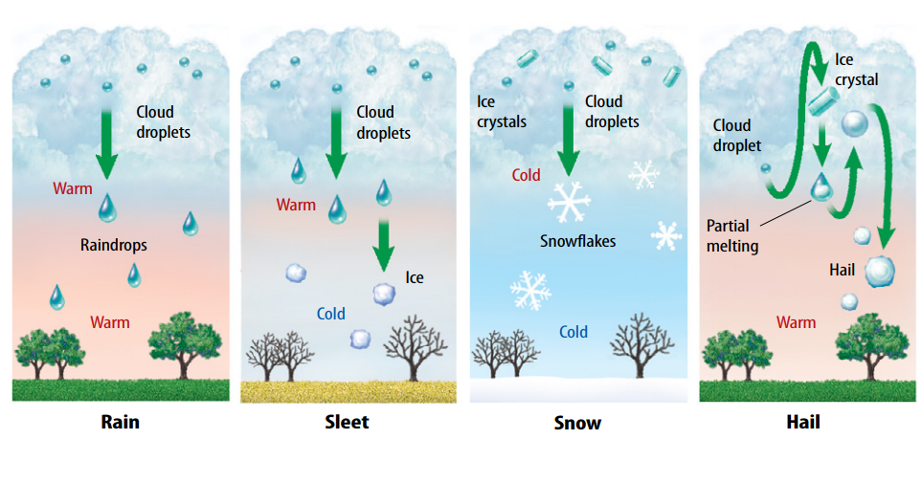
Warm Up 4 min 9/21/18 Friday
Write the Types of Precipitation.

Slide 2
Today Agenda
1) Warm up 4 min
2) Flocabulary classwork 30 min
3) Kahoot/ Quizlet Live 10 min
If you wanted to retake the test *some students below average* you can retake through socrative.com
Room name is TMSACOMPUTER

Slide 3
Flocabulary
1) Class Codes Have students visit www.flocabulary.com/join-class and enter the class code.
Carver: QRCQ9F
McNair: 4DJ5YD
Darwin: 6Z9RWV
Gursey: DDJGQV
Bluford: S6SCHY

Slide 4
Flocabulary Assignment 100 points
Video (20 Points)
Watch a video about the topic.
Vocab Cards (20 Points)
Write and draw to build understanding of vocab words.
10 CARDS
Vocab Game (20 Points)
Practice vocab words while building a beat.
Read & Respond (20 Points)
Dive deeper into the topic and answer practice questions.
Quiz (20 Points)
Show understanding of the topic.

Slide 5
Kahoot
https://play.kahoot.it/#/?quizId=b7485877-101a-477d-89ce-b8afe09df3c0

Slide 6
Quizlet Live
https://quizlet.com/311028001/weather-flash-cards/

