Slide 1
Warm Up 1-23-17
Why was the invention of the light microscope helpful to scientists ?
A. The microscope helped people focus light
B. The microscope made it possible for people
learn about cells
C. The microscope helped scientists understand
how to use lenses.
D. The microscope helped learn about atoms

Slide 2
Today Agenda
1) Warm Up 5 minutes
2) Study Guide go over (Science Benchmark)
3) Jeopardy Game

Slide 3
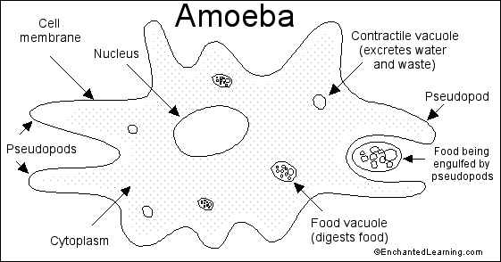
1
1) Rough sketch- False Feet (Pseudopods)

Slide 4
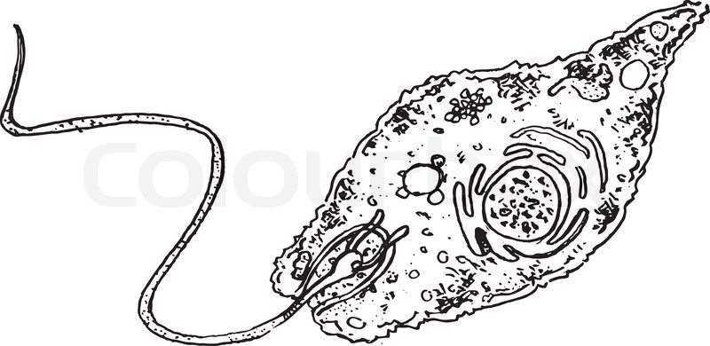
Study Guide
2)Euglana Draw Sketch-performing photosynthesis

Slide 5
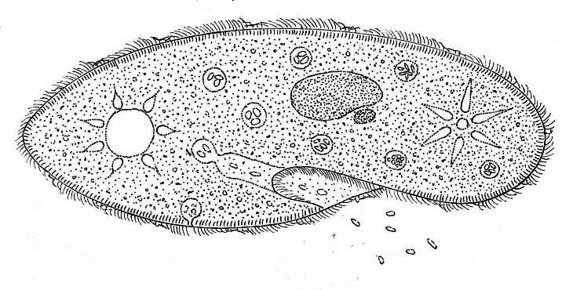
3-Paramecium (Hair like structure –Cilia) Get food by using small, hair like threads to sweep particles into small cavity

Slide 6
Study Guide
4) How does a volvox move? What is unique about volvox?
Each cell of the Volvox colony has two flagella facing outward from the sphere. Waving the flagella makes the colony tumble slowly through the water.
They can rotate in large, connected group. (Unique about volvox)

Slide 7
Study Guide
5) Why are algae considered plant-like protist?
They produce their own food through photosynthesis.

Slide 8
Study Guide
6) Compare and Contrast plant animal using venn diagram

Slide 9
Study Guide
7) Describe the roles of following cell organelles;
Mitochondria; Transfer energy and produce
Nucleus; Control all cell activities and contain the genetic material. ( Eukaryotic cell )
Vacuole; it functions to hold materials and wastes
Golgi body; Act like packing area
E.R; Transporting materials through cell
Ribosome; is a cell structure that makes protein
Cell Membrane; it helped them remove waste

Slide 10
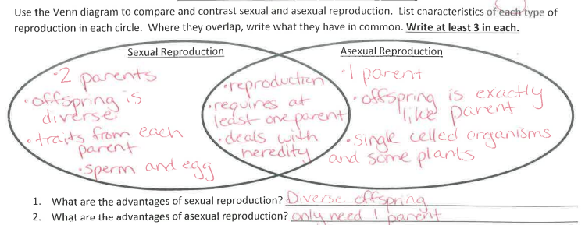
Study Guide
8) Compare and Contrast Asexual Vs Sexual Reproduction

