Slide 1
9/30/2016 Friday Warm Up
What is isobar?
What is isotherm?

Slide 2
Answer
Isobars are lines of equal average air pressure at sea level.
Lines of equal temperature are called isotherms. Isotherms show temperature gradients and can indicate the location of a front.

Slide 3
Today Agenda
Warm Up 5 minutes
Project (Severe Weather 40 minutes) Here is the steps for project.

Slide 4
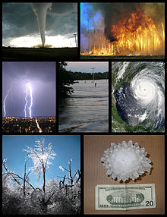
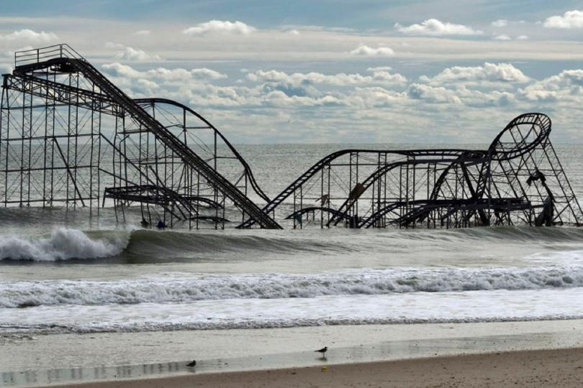
First Step (5 point)
1) Draw and Cause and Effect picture of severe weather . (5 points) Some example; Flood, fire

Slide 5
2. Step (5 point)
Write a letter a victim of tornado/hurricane showing your sympathy for their circumstances. (5 Points)
For example; Words cannot express how sorry we are about the recent tragic events that have touched you so deeply. Your loss is huge, and we can only imagine the hurt you feel.
We want you to know that you are in our thoughts and prayers. Please accept our condolences and our hopes for your healing and renewal.
With sympathy,

Slide 6
3.Step
Make a detailed plan of action to help those affected by a tornado /hurricane.
Get inside, head to a shelter, or get your emergency kit together if:
Local authorities issue a storm watch or warning over the news
You see a strong, persistent rotation in the cloud base, or whirling dust or debris on the ground under a cloud
A heavy hail or rain storm is immediately followed by a dead calm or a fast shift in wind
You hear a thunder sound that doesn’t fade after a few seconds
You see the ocean near you swell, or hear waves hit the shoreline almost every 9 seconds
Wind speeds continue to pick up and grow steadily
Heavy wind followed by a driving rain that only gets worse

Slide 7
4.Step (15 point)
Come up with the safety procedure for people living in areas that are frequently threatened with severe weather.
For the sample link;
https://www.farmers.com/catastrophe/tornado-and-hurricane-preparation/

Slide 8
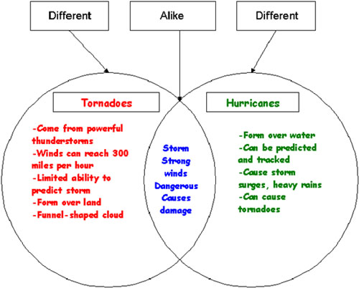
5.Step (5 Point)
Compare and Contrast using a Venn diagram how hurricanes and tornadoes are similar and different. (5 Point)

Slide 9
6.Step (15 point)
Invent a new weather tool to help better predict tornadoes. Include an illustration and description. (15 points)
\ A DEBRIS BALL SIGNATURE CAN VERIFY TORNADOES WITH 70 TO 80 PERCENT ACCURACY
This new radar has also helped forecasters establish more accurate tornado signatures, like the "debris ball," wherein material being carried in the vortex of a tornado can be spotted before the storm touches down. A debris ball signature can verify tornadoes with 70 to 80 percent accuracy. The four-dimensional storm cell investigator is still being tweaked and improved, but it's hoped that the technology will roll out to more radar stations across the US in the coming decade.

