Slide 1
9/27/2016 Tuesday Warm Up
Imagine that it is summertime and air around you is warm and humid. What type of weather can you expect as a cool, dry air mass rapidly approaches?

Slide 2
Answer
Thunderstorms.

Slide 3
Page 47
Convection; the transfer of thermal energy by the circulation or movement of a liquid or gas
Thermal conduction; is the transfer of thermal energy through material
Radiation; the transfer of energy as electromagnetic waves.

Slide 4
Page 50-51 –Global Winds and Local Winds
Wind; The movement of air caused by differences in air pressure is called wind. Wind is a example of convection.
Convection cell; Air travels in many large, circular patterns called convection cell.

Slide 5
Video time
https://www.youtube.com/watch?v=xCLwbqmacck
Why does the air blow?

Slide 6
Page 52 Coriolis effect and Global winds
Coriolis effect; The apparent curving of the path winds and ocean currents due to the Earth’s rotation.
The combination of convection cell found at every 30* of latitude and the Coriolis effect produces patterns of air circulation called global winds.

Slide 7
Video-Coriolis effect
https://www.youtube.com/watch?v=i2mec3vgeaI

Slide 8
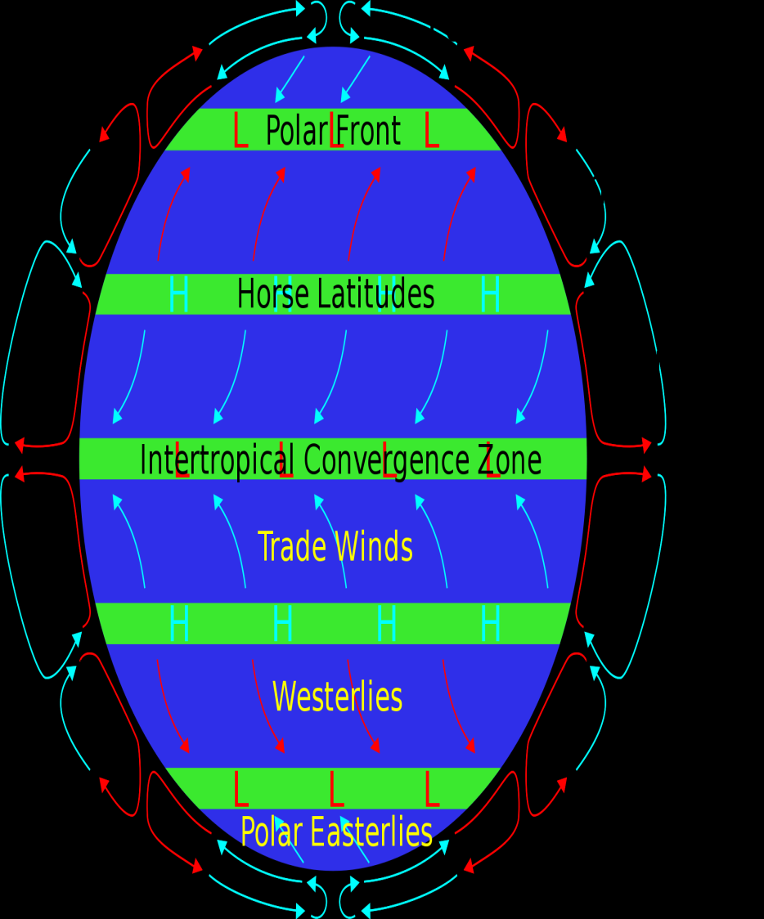
Page 52 Type of Global winds
Polar easterlies; The wind belts that extend from the poles to 60* latitude in both hemisphere are called polar easterlies.
Westerlies; The wind belts found between 30* and 60* latitude in both hemisphere are called westerlies; comes from west and curves east.

Slide 9
Page 52
Trade winds; In the both atmosphere , the winds blow 30* latitude almost to the equator are called trade winds.

Slide 10
Page 54-Jet Streams
The jet streams are narrow belts of high speed winds that blow in the upper troposphere and lower stratosphere.
These wind can reach maximum speed of 400 km/h.
Moves south in the winter, north in the summer time.

Slide 11
Summary Video
http://studyjams.scholastic.com/studyjams/jams/science/weather-and-climate/air-pressure-and-wind.htm
Study Jams

