Slide 1
Warm Up 10/13/2016
What are the two main type of microscope?
What are the differences between SEM and TEM ?

Slide 2
Answer
1) Light microscope (including compound ) and Electron microscope ( SEM and TEM)
2) TEM are usually used to study extremely small things (dead organism can be viewed with TEM)
SEM are usually used to study object’s surface. (3-D image of an object)

Slide 3
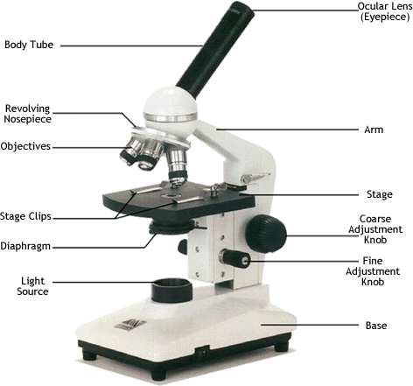
Microscope Parts

Slide 4
Parts
1) Resolving nosepiece; holds the objectives and rotates to change the magnification.
2) Objective; are found on the resolving nosepiece and range from 4X to 100X
3) Stage; are used to hold the slide in place.

Slide 5
Parts
A microscope should be carried mostly by the arm.
Coarse wheel adjustment; brings the microscope into rapid, but not detailed focus.

Slide 6
Parts
Fine Wheel adjustment; sharpens the focus of your objective.
Lowest objective; a slide under a microscope you should start by using.

Slide 7
Part
To calculate total magnification one should multiply the ocular lens and objective lens.

