Slide 1
Microscope Care
Always carry with 2 hands
Never touch the lenses with your fingers.
Only use lens paper for cleaning
Do not force knobs
Keep objects clear of desk and cords
When you are finished with your "scope", rotate the nosepiece so that it's on the low power objective, roll the stage down to lowest level, rubber band the cord, then replace the dust cover.
.

Slide 2
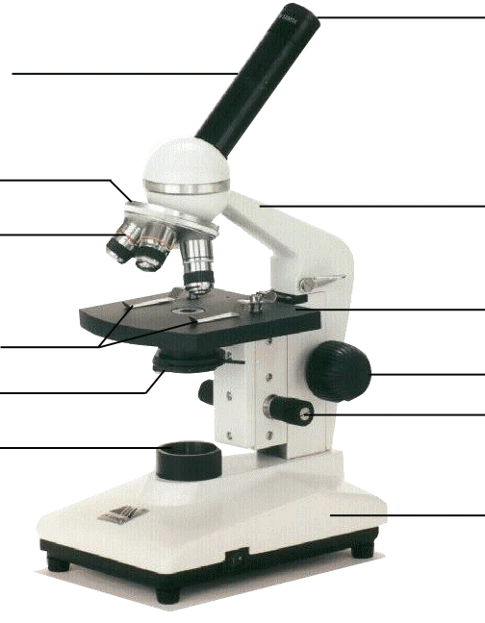
Microscope Parts
Ocular lens
Body Tube
Revolving Nosepiece
Arm
Objective Lens
Stage
Stage Clips
Coarse adjustment knob
Diaphragm
Fine adjustment knob
Light
Base

Slide 3
ocular lens
Ocular lens
magnifies; where you look through to see the image of your specimen.
They are usually 10X or 15X power. Our microscopes have an ocular lens power of 10x.

Slide 4
arm
supports the tube and connects it to the base
arm

Slide 5
stage
the flat platform where you place your slides
stage

Slide 6
coarse adjustment knob
moves stage (or body tube) up and down
coarse adjustment knob

Slide 7
fine adjustment knob
small, round knob on the side of the microscope used to fine-tune the focus of your specimen
after using the coarse adjustment knob
fine adjustment knob

Slide 8
base
the bottom of the microscope, used for support
base

Slide 9
body tube
body tube
connects the eyepiece to the objective lenses

Slide 10
revolving nosepiece
the part that holds two or more objective lenses
and can be rotated to
easily change power
revolving nosepiece

Slide 11
objective lenses
Adds to the magnification
Usually you will find 3 or 4 objective lenses on a microscope. They almost
always consist of 4X, 10X, 40X and 100X powers. When coupled with a 10X (most common)
objective lens

Slide 12
objective lenses
eyepiece lens, we get total magnifications of 40X (4X times 10X), 100X , 400X and 1000X.
The shortest
lens is the lowest power, the longest one is the lens with the greatest power. Lenses are color coded.
objective lenses

Slide 13
objective lenses
The high power objective lenses are retractable (i.e. 40XR). This means that if they hit a slide, the end of the lens will
push in (spring loaded) thereby protecting the lens and the slide.
objective lenses

Slide 14
stage clips
Stage clips hold the slides in place. If your microscope has a mechanical stage, you will be able to move the slide around by turning two knobs. One
moves it left and right, the other moves it up and down.
stage clips

Slide 15
diaphragm
controls the amount of light going through the specimen
Many microscopes have a rotating disk under the stage. This diaphragm has different sized holes and is used to vary the intensity and size of the cone of light
diaphragm

Slide 16
diaphragm
that is projected upward into the slide. There is no set rule regarding which setting to use for a particular power. Rather, the setting is a function of the transparency of the specimen, the degree of contrast
you desire and the particular objective lens in use.
diaphragm

Slide 17
light
makes the specimen
easier to see
light

Slide 18
Using the Microscope
The proper way to focus a microscope is to start with the lowest power objective lens first and while looking from the side, crank the lens down as close to the specimen as possible without touching it. Now, look through the eyepiece lens and focus upward only until the image is sharp. If you can't get it in focus, repeat the process again.

Slide 19
Using the Microscope
Once the image is sharp with the low power lens, you should be able to simply click in the next power lens and do minor adjustments with the focus knob. If your microscope has a fine focus adjustment, turning it a bit should be all that's necessary. Continue with subsequent objective lenses and fine focus each time.

Slide 20
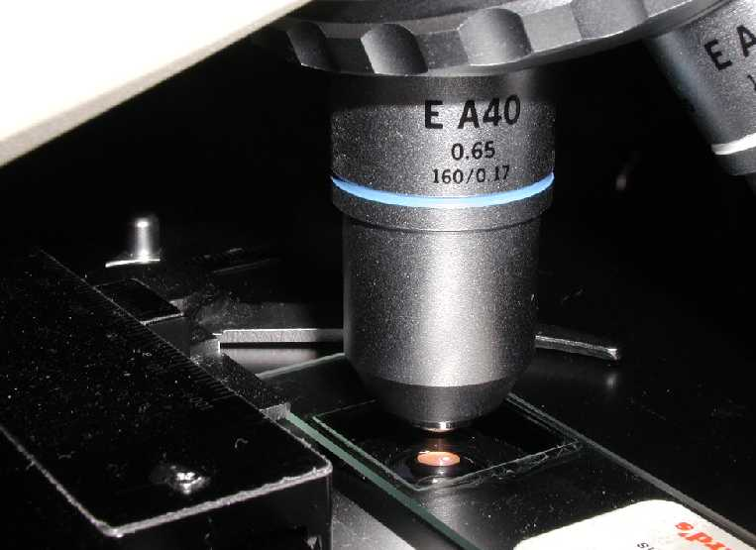
Using High Power
Rotate to 40x objective, locate desired portion of specimen in the center of the field. Refocus very carefully so that the specimen is focused as sharply as
possible. (Do not
alter focus for the
Following steps )

Slide 21
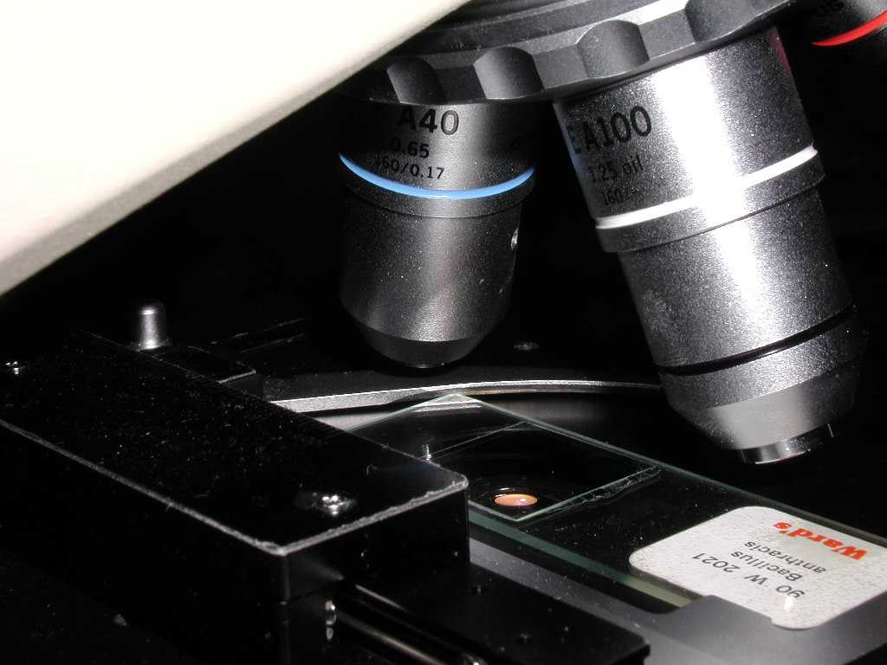
Using High Power
Partially rotate so that 40x and 100x objectives straddle the specimen.

Slide 22
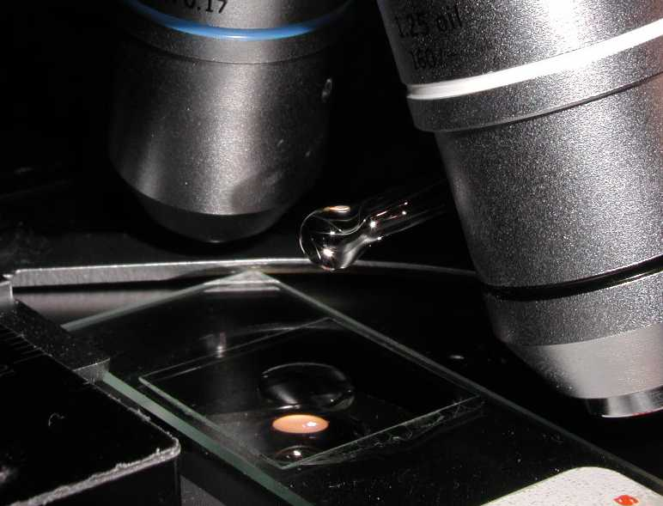
Using High Power
Place a small drop of oil on the slide in the center of the lighted area. (Take care not to dribble on the stage.)
Put the small drop
of oil directly over
the area of the
specimen to be
Examined.

Slide 23
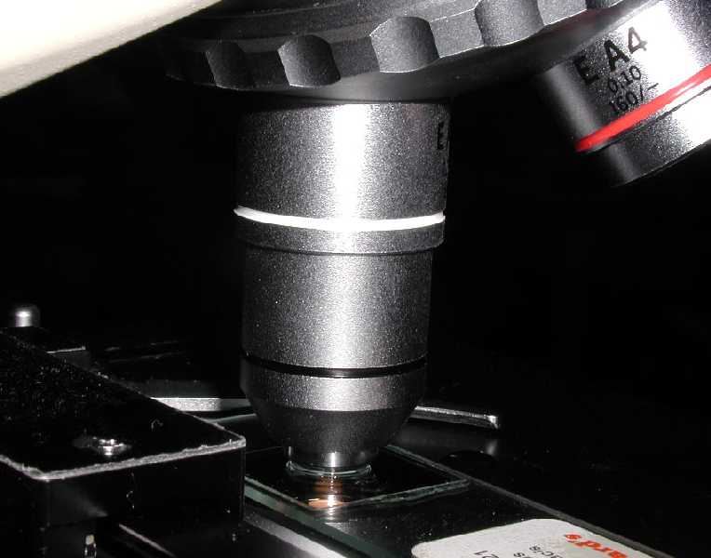
Using High Power
Rotate so that the 100x oil immersion objective touches the oil and clicks into place.

Slide 24
Using High Power
Focus only with fine focus. Hopefully, the specimen will come into focus easily. Do not change focus dramatically.

Slide 25
Using High Power
Clean up!: When you have finished for the day, wipe the 100x oil immersion objective carefully with lens paper to remove all oil. Wipe oil from the slide thoroughly with a Kimwipe. Cleanse stage should any oil have spilled on it. Recap the immersion oil container securely, replace in drawer.

