Slide 1
Study Guide
1) What is a force?
A pull or push on an object
2) What is Newton’s First Law?
An object at rest stays at rest and an object in motion stays in motion with the same speed and in the same direction unless acted upon by an unbalanced force.

Slide 2
Study Guide
3) Provide an example of Newton’s First Law .
Hockey puck, kicking a soccer ball
4) What is inertia? Can an object’s inertia change?
Inertia is the resistance of any physical object to any change in its state of motion; this includes changes to its speed, direction, or state of rest. Yes it can change with mass of object.

Slide 3
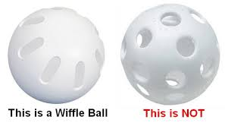
Study Guide
5) Which has more inertia? A bowling ball or a whiffle ball ? Why ( A bowling ball has more mass and it has more inertia)
6) What is Newton’s Second Law?
Acceleration is produced when an unbalanced force acts on an object(Mass). F= Mx A (Force = mass x acceleration

Slide 4
Study Guide
7) If an object has a mass of 50 kg and is accelerating at 2m/s/s, what is the force it will exert?
F= mxa Force will be 50x 2= 100 N
8) What is Newton’s Third Law of motion ?
For every action, there is an equal and opposite reaction.
9) Provide an example of Newton’s Third Law
When air rushes out of a balloon, the opposite reaction is that balloon flies up.

Slide 5
Study Guide
10) What is balanced force?
Balanced forces when two forces acting on an object are equal in size and cancel each other. (Net force=0)
11) What is unbalance force?
Unbalanced forces when two forces acting on an object are not equal in size
12) If an object is stationary, all forces must be…….
Equal in size , Balanced force , net force = 0

