Slide 1
Use the above word bank to fill in the blanks. Write the sentence, fill in the black, and underline the word you used.
Melanin | Perspiration | Cardiac Muscle
Skeletal Muscle | Smooth Muscle | Skin
Muscular System | Skeletal System | Cartilage

Slide 2
1)Skin
1) ___________ is the body system that gives the sense of touch, offers protection, and regulates internal body temperatures.

Slide 3
2)Perspiration
The human body uses ________________ to remove heat from the body in the form of sweat.

Slide 4
3)Skeletal Muscle
The type of muscle that connects to bones and allows for movement is ____________________.

Slide 5
4)Cartilage
______________ covers the ends of bones and reduces the amount of friction between them.

Slide 6
5)Smooth Muscle
The type of muscle that lines most of our internal organs is _____________________.

Slide 7
6)Melanin
Skin that has more _________________ will be darker.

Slide 8
7)Muscular System
The ___________________________ is the body system that allows the body to move

Slide 9
8)Cardiac Muscle
_______________________ is a type of muscle that is only found in the heart

Slide 10
9)Skeletal System
The body system that protects our internal organs and stores calcium is the _____________________.

Slide 11
10)
What is the main difference between a ligament and a tendon?
Tendons may also attach muscles to structures such as the eyeball.
A ligament is a fibrous connective tissue which attaches bone to bone

Slide 12
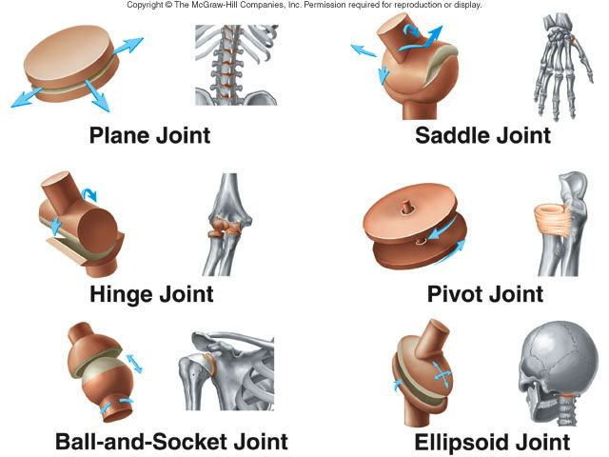
11)
What is a joint? Name three examples of them.
A joint is the point where two or more bones meet.

Slide 13
12)
What does red bone marrow produce?
Red bone marrow produce red blood cell.

Slide 14
13)
Explain the difference between involuntary and voluntary muscles
Voluntary muscles are the muscles you can control. You can't control involuntary muscles.

Slide 15
14)
Name two reasons why humans perspire.(Sweat)
High temperature
Emotions and stress

Slide 16
15)
How are the skeletal system and muscular system related? Name two ways
The skeleton is a frame. The muscles are attached to the frame by tendons.
The muscles pull the bones, causing movement.

