Slide 1
1-11-17 Warm Up 5 minutes
When scientist speak of genetic traits, what are they referring to?
2) Humans normally have 23 pairs of chromosomes. Sometimes people are born with 47 chromosomes. This is example of ;

Slide 2
Answer
1) Human characteristic that are inherited from our parents
2) A genetic disorder.

Slide 3
Today Agenda
1) Warm up 5 minutes
2) Natural Selection Brain Pop Video
3) Definition of vocabulary
4) Classroom Activity
5) Pop Quiz
6) Homework

Slide 4
Vocabulary
1) A species is often defined as the largest group of organisms in which two individuals can produce fertile offspring, typically by sexual reproduction.

Slide 5
Ancestor
The actual or hypothetical form or stock from which an organism has developed or descended.

Slide 6
Specialization
The adaptation of an organism or organ to a special function or environment

Slide 7
Environmental Pressure
Environmental pressures are the activities and factors that cause environmental change. They include land use, extraction of resources, greenhouse gas emission, water use and energy use.

Slide 8
Variation(in biology)
Any difference between groups of organisms of any species caused either by genetic differences (genotypic variation) or by the effect of environmental factors on the expression of the genetic potentials.

Slide 9
Mutation
A mutation occurs when a DNA gene is damaged or changed in such a way as to alter the genetic message carried by that gene.

Slide 10
Offspring
In biology, offspring are the young born of living organisms,
Survival of the fittest; implies that strong will succeed and the weak shall perish
http://study.com/academy/lesson/survival-of-the-fittest-herbert-spencer-definition-examples-quiz.html

Slide 11
Evolution
Evolution is change in the heritable characteristics of biological populations over successive generations.
Extinction; In biology and ecology, extinction is the end of an organism or of a group of organisms, normally a species

Slide 12
Open Notebook Quiz notes Environment and Lifestyle Choices on Biological Inheritance
Characteristics of organism; a combination of genes and environment determine the characteristics of organisms.
Genetic contribution of parents to offspring; Each parent gives half of their genetic information to their offspring
Using drugs, alcohol, tobacco is lifestyle choice however you cannot chose your genetics.

Slide 13
Open Notebook Quiz notes Environment and Lifestyle Choices on Biological Inheritance
Human born with 47 chromosomes (A genetic disorder) 46 Normal human being
Poor water, air quality are environmental factors which affect growth and development.
If the mother drink alcohol during pregnancy brain will be damaged.
Smoking effect on fetus ; reduced to birth weight.
Smoking cigarettes can ; cause lung damage, damage a developing embryo , become additive.

Slide 14
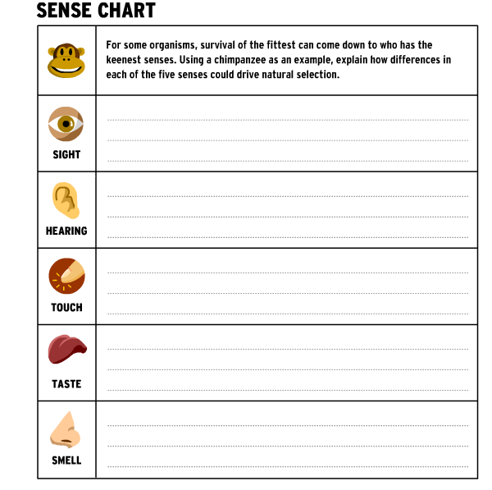
Activity

Slide 15
Pop-Quiz

Slide 16
Homework

