Slide 1
1/3/18 Wednesday Warm Up 5 minutes

Slide 2
Warm Up Answer
1) Like a car, a new cell must be made from many parts that are put together in the proper way. For both cars and cells, a plan for assembly must exist and be followed.
2) Cells are very small, and a large organism is composed of a huge number of cells. As old cells wear out, copies are made to replace them.
3) Yes, cells are always being copied in the human body. In children and teens, copies of cells allow the growth of bones, muscles, and other body tissues. In people of all ages, copies of cells replace old cells that the body sheds or destroys.

Slide 3
Today Agenda
1) Warm Up 5 minutes
2) Lesson 1 Introduction (Science Journal-Taking Notes)- 25 minutes
3) Lesson Vocabulary- Classwork 5 minutes
4) Video 5 minutes (Brain Pop)
5) Homework
Field Trip Money Due 1/5/18 (This Friday)

Slide 4
2nd Quarter Agenda (January 19th-Last Day) Write Science Journal-Great Reminder
Lesson 1: The Cell Cycle and Cell Division (3 days)
Lesson 2: Levels of Organization (3 days)
Lesson 3; Genetic disorder (2 days)
Chapter Wrap-Up and Unit Test and Benchmark
1/17/18- Unit Test
1/18/18 or 1/19/18 (Science 2nd Quarter Benchmark)

Slide 5
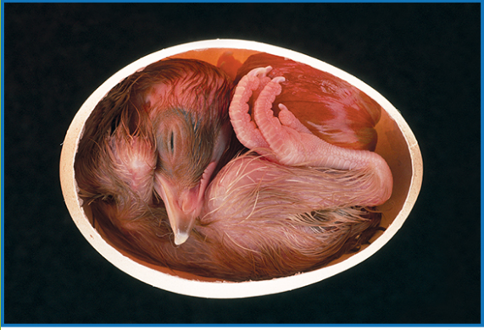
From a Cell to an Organism- Science Journal (Q&A)
What’s happening inside?
Look at the photo at the beginning of the chapter. From the outside, a chicken egg looks like a simple oval object. But big changes are taking place inside the egg. Over several weeks, the one cell in the egg will grow and divide and become a chick.
How did the original cell change over time?
What might have happened to the chick’s cells as the chick grew?
How can one cell become a multicellular chick?

Slide 6
From a Cell to an Organism
How can one cell become a multicellular organism?
Through cell division, one cell can produce new cells to grow and develop into a multicellular organism.

Slide 7
From a Cell to an Organism- Science Journal
Lesson 1: The Cell Cycle and Cell Division
The cell cycle consists of two phases. During interphase, a cell grows and its chromosomes and organelles replicate. During the mitotic phase of the cell cycle, the nucleus divides during mitosis, and the cytoplasm divides during cytokinesis.
The cell cycle results in two genetically identical daughter cells. The original parent cell no longer exists.
The cell cycle is important for growth in multicellular organisms, reproduction in some organisms, replacement of worn-out cells, and repair of damaged cells.

Slide 8
1
The Cell Cycle and Cell Division
Do you agree or disagree?
Cell division produces two identical cells.
Agree. The mitotic phase of the cell cycle creates two identical cells.

Slide 9
1
The Cell Cycle and Cell Division
Do you agree or disagree?
Cell division is important for growth.
Agree. Growth depends on cells dividing and creating more and more cells.

Slide 10
1
The Cell Cycle and Cell Division
Do you agree or disagree?
At the end of the cell cycle, the original cell no longer exists.
Agree. The mitotic phase of the cell cycle transforms the original cell into two separate new cells.

Slide 11
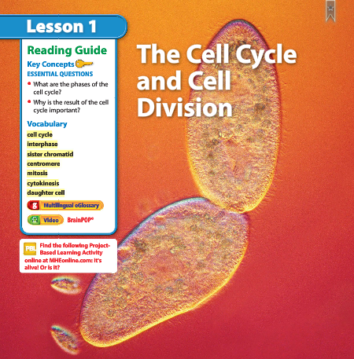
1
The Cell Cycle and Cell Division
Time to Split?
Look at the photo at the beginning of the lesson. Unicellular organisms such as these reproduce when one cell divides into two new cells. The two cells are identical to each other.
What do you think happened to the contents of the original cell before it divided?

Slide 12
1
The Cell Cycle and Cell Division- Definition will be next slide.
cell cycle
interphase
sister chromatid
centromere
mitosis
cytokinesis
daughter cells

Slide 13
Lesson 1 Vocabulary- Classwork
Cell cycle: growth, development, and division
Centromere structure that holds sister chromatids together
Cytokinesis division of a cell’s cytoplasm and contents
Daughter cells two new cells that result from mitosis and cytokinesis
Eukaryotic cell with membrane bound structures
Interphase cell’s period of growth and development
Mitosis division of a cell’s nucleus and contents
Sister chromatids one of the two identical strands of DNA that make up a duplicated chromosome

Slide 14
Video
Brain Pop

