Slide 1
Homework check 1/9/18
1. The three stages of interphase are rapid growth and replication of the organelles, replication of DNA, and preparation for cell
division.
2. Interphase prepares the cell to reproduce in the mitotic phase.
3. The two stages of the mitotic phase are mitosis and cytokinesis.
4. When a cell divides into daughter cells, the
original cell no longer exists

Slide 2
Warm Up 1/9/18 Tuesday
1) You are about the watch the video about mitosis(rap)-3;17 minutes
Write summary of the video (phases)- two sentences.

Slide 3
Today Agenda 1/9/18 Tuesday
1) Homework check/ Bell Ringer 10 minutes
2) Introduction Lesson 2 15 minutes
3) Lesson Vocabulary 10 minutes
4) Lesson Outline 5 minutes
5) Review 3 minutes

Slide 4
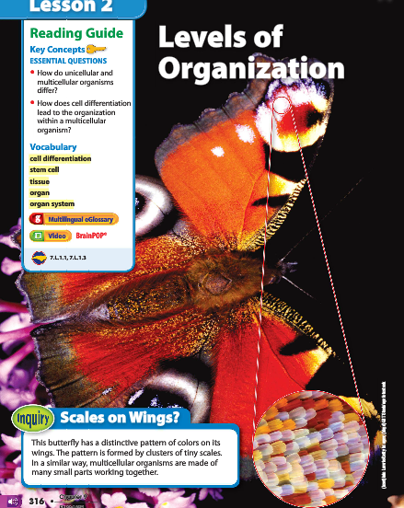
2
Levels of Organization- No writing
Scales on Wings?
Look at the photo at the beginning of the lesson. This butterfly has a distinctive pattern of colors on its wings. The pattern is formed by clusters of tiny scales. In a similar way, multicellular organisms are made of many small parts working together.

Slide 5
2
Levels of Organization- Science Journal
Do you agree or disagree?
Unicellular organisms do not have all the characteristics of life.
Disagree. Unicellular organisms have all the characteristics of life.

Slide 6
2
Levels of Organization- Science Journal
Do you agree or disagree?
All the cells in a multicellular organism are the same.
Disagree. All the cells in a multicellular organism have the same DNA, but they are specialized in structure and function.

Slide 7
2
Levels of Organization- Science Journal
Do you agree or disagree?
Some organs work together as part of an organ system.
Agree. Groups of different organs work together as a system to complete a series of tasks.

Slide 8
2
Levels of Organization- Science Journal
How do unicellular and multicellular organisms differ?
The one cell of a unicellular organism is able to obtain all the materials that it needs to survive. In a multicellular organism, cells cannot survive alone and must work together to provide the organism’s needs.

Slide 9
2
Levels of Organization- Science Journal
How does cell differentiation lead to the organization within a multicellular organism?
Through cell differentiation, cells become different types of cells with specific functions. Cell differentiation leads to the formation of tissues, organs, and organ systems.

Slide 10
Lesson 2 Vocabulary Classwork 5 minutes
cell differentiation process by which cells become different types of cells
complex made of two or more parts
fiber long muscle cell organ group of different tissues working together to perform a particular job
organ system group of organs working together to complete a series of tasks
stem cell unspecialized cell that develops into many different cell types
tissue group of similar types of cells that work together to carry out specific tasks
Answer;
1. stem cell
2. fiber
3. cell differentiation
4. organ system
5. tissue
6. organ
7. complex

Slide 11
Lesson Outline

