Slide 1
Warm Up 10/16/17 Monday
1)Which of the following is a valid method for reducing the amount of greenhouse gases in the atmosphere?
A. Reduce the use of chemicals that
destroy ozone in the stratosphere.
B. Decrease the use of alternative fuel
sources such as solar energy.
C. Decrease the amount of fossil fuels
burned by cars.
D. Decrease the amount of acid rain in
the sky by altering cloud patterns.
Answer; C

Slide 2
Today Agenda
1) Warm up 5 minutes
2) STEM Fair STEP 3 –Reminder due is today
3) Flocabulary Atmosphere/Weather 15 minutes (Fill in the blank/Vocabulary Card/Read and Respond/quiz/lyric Lab
4) Video-Weather Instrument 5 minutes
5) Make an anemometer 15 minutes
6) Exit Ticket 3 minutes

Slide 3
Objectives and Standard
7.E.1 Understand how the cycling of matter (water and gases) in and out of the atmosphere relates to Earth’s atmosphere, weather and climate and the effects of the atmosphere on humans. (Standard)
7.E.1.4 Predict weather conditions and patterns based on information obtained from: (Objectives)
• Weather data collected from direct observations and measurement (wind speed and direction, air temperature, humidity and air pressure) (Objectives

Slide 4
STEM FAIR

Slide 5
Flocabulary-15 minutes
1) Watch the video (Fill the blanks)
2) Quick Review
3) Watch the video (Classroom Discussion)
4) Chromebook and sign up for the Flocabulary Classroom.

Slide 6
Flocabulary
To sign up, have students do the following:
Visit www.flocabulary.com/join-class
Enter the class code CF8TNR (Umad)
GFZ4BS (Berkeley)
9VH6Q2 (Caltech)
2JFHNH (Texas)
KWCVHT (Bosporus)
Select whether they are new to Flocabulary OR already have an account.(Remember, students only need one Flocabulary account, but they can still be in multiple classes.)
Fill in additional information as prompted to join the class.

Slide 7
Video
Plicker questions

Slide 8
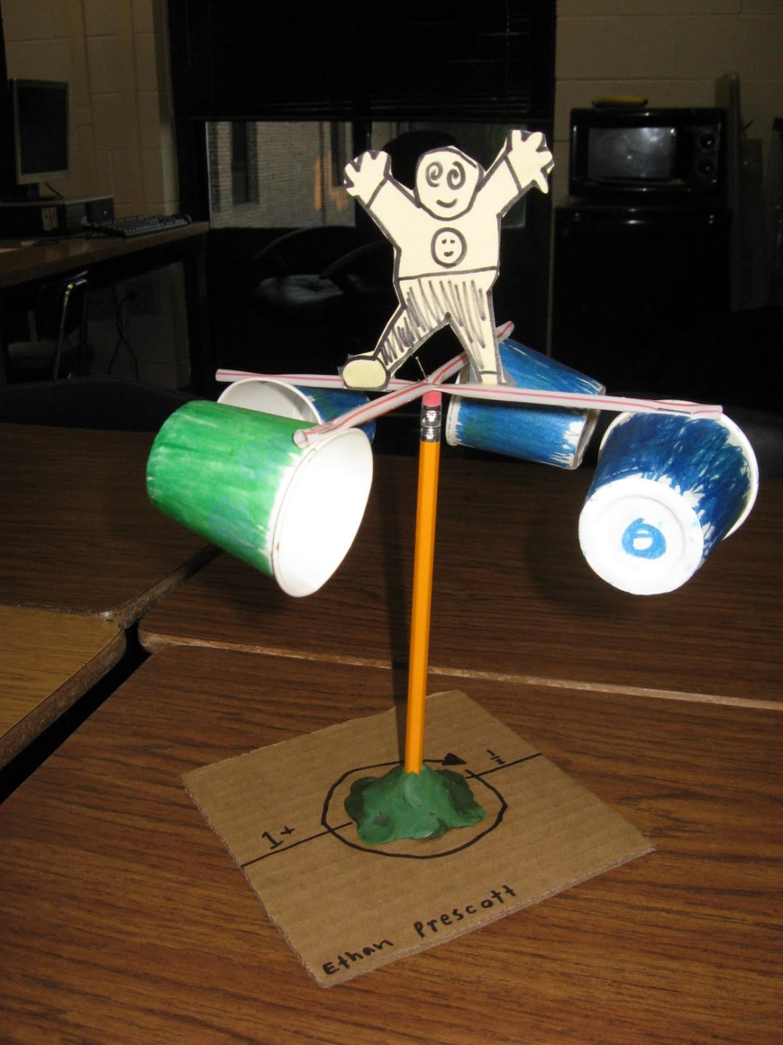
Make an anemometer-
Group of 4 students- There will be 5 group.
1) One time keeper
2) Official counter of the day
3) One holder
4) Group Leader.

Slide 9
Exit Ticket
Go to www.socrative.com
Click student log in
Room name BOSPHORUS
YOUR ID IS YOUR PLICKER NUMBER
Teacher Question- What is your anemometer number of spins (Best score)

Slide 10
FLL
To sign up, have students do the following:
Visit www.flocabulary.com/join-class
Enter the class code QQ579R Select whether they are new to Flocabulary OR already have an account.(Remember, students only need one Flocabulary account, but they can still be in multiple classes.)
Fill in additional information as prompted to join the class.
You have two assignment (Rap of the week due is today.
Robot assignment due is tomorrow)

