Slide 1
Warm Up 5 minutes 10/17/17
What is the order of the events for the water cycle on a typical warm day?
Answer; evaporation, condensation, precipitation
2) Water located in wells underground is
Answer; Ground Water
3) The thickest and lowest level of the atmosphere in which most organisms live is the…….
Answer; troposphere

Slide 2
Today Agenda
1) Warm Up 5 minutes
2) Video (engage)/Content Vocabulary
3) Power Point Slide- Instruction (Lesson Outline)
4) Classwork Content Practice A
5) Homework Content Practice B

Slide 3
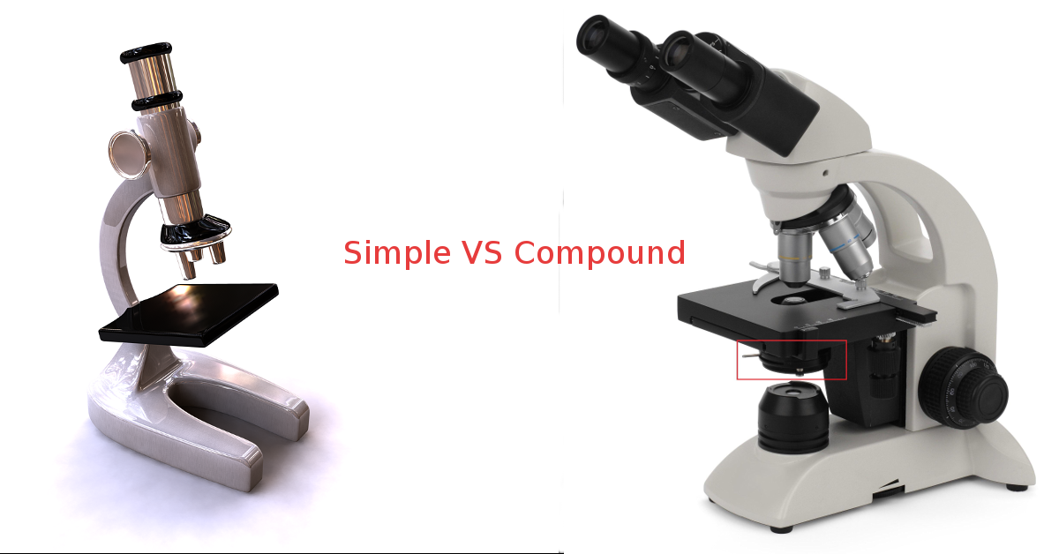
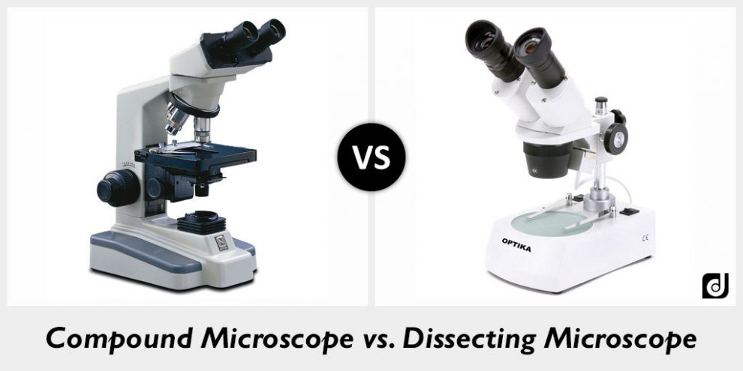
Video

Slide 4
Presentation
Please Answer the lesson outline question with the power point presentation.

Slide 5
A. The Development of Microscopes
1. The invention of microscopes enabled people to see details of living things that cannot be seen with the unaided eye.
2. Two inventors of early microscopes were Anton van Leeuwenhoek and Robert Hooke.
3. Before microscopes, people did not know that living things are made of cells.

Slide 6
B. Types of Microscopes
1. One characteristic of all microscopes is that they magnify images. Magnification makes an image appear larger than it really is.
2. Another characteristic of microscopes is resolution—how clearly the magnified image can be seen.
3. Light microscopes use light and lenses to enlarge an image of an object.
a. A light microscope that uses more than one lens to magnify an image is called a(n) compound microscope.
b. Light microscopes can be used to view living or nonliving things.
c. Light microscopes can enlarge images up to 1,500 times their original size.

Slide 7
B. Types of Microscopes
4. Electron microscopes use a magnetic field to focus a beam of electrons through an object or onto an object’s surface.
a. Because objects must be mounted in plastic and then sliced very thin, only dead organisms can be viewed with an electron microscope.
b. Transmission electron microscopes usually are used to study extremely small things such as the structures inside a cell.
c. Scanning electron microscopes usually are used to study the surface of an object

Slide 8
C. Using Microscopes
1. People in health care, such as doctors and laboratory technicians, often use microscopes. Microscopes are used in surgery, such as cataract surgery and brain surgery.
2. Forensic scientists use microscopes to study evidence from crime scenes.
3. The steel industry examines steel for impurities with the use of microscopes.
4. Jewelers use microscopes to identify stones

Slide 9
Content Practice A
1) Magnify
2) Resolution
3) Hooke
4) Light Microscope
5) Compound Microscope
6) Light Microscope
7) Compound Microscope
8) Electron Microscope
9) Electron Microscope
10) Light Microscope

Slide 10
Content Practice B-Homework
5 questions

