Slide 1
Warm Up 5 minutes 10/19/17 Thursday
1) This part of the microscope that holds the
objectives and rotates to change the magnification
Answer; Revolving nosepiece
2) These are found on the revolving nosepiece and range from 4x to 100x.
Answer; objective

Slide 2
Today Agenda
1) Warm Up 5 minutes
2) Key concept builder(4 pages)- 20 minutes
3) Making Foldable (Page 733 on packet)-10 minutes
4) Lesson Review 10 minutes (8 question )

Slide 3
Key Concept Builder-20 minutes
Please use your notes and packet about lesson and answer the question. You have 20 minutes for 4 pages.
Good luck.

Slide 4
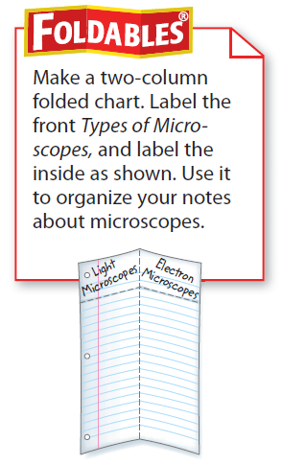
Foldable- 10 minutes
Make a two-column folded chart. Label the
front Types of Microscopes, and label the inside as shown. Use it to organize your notes about microscopes

Slide 5
10 minutes
1 Define the term light microscope in your
own words.
2 A(n) focuses a beam of electrons through an object or onto an object’s surface.
3 Explain how the discovery of microscopes has changed what we know about living things.
4 Which microscope would you use if you wanted to study the surface of an object?
A. compound microscope
B. light microscope
C. scanning electron microscope
D. transmission electron microscope
Interpret Graphics
5 Identify Copy and fill in the graphic
organizer below to identify four uses of
microscopes .
6 Compare the images of the white blood cells below. How do they differ?
7 Develop a list of guidelines for choosing a microscope to use.
8 A student observes a blood sample with a compound microscope that has a 10× ocular lens and a 40× objective lens. How much larger do the blood cells appear

