Slide 1
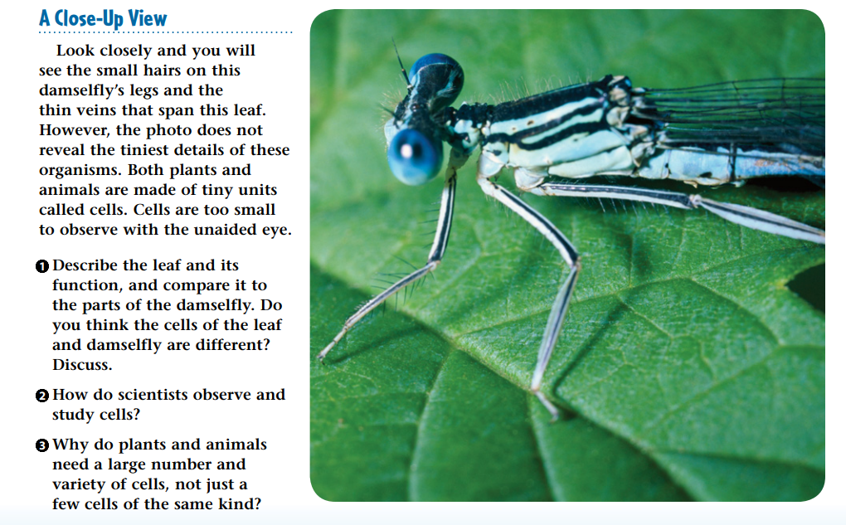
WARM UP 5 MINUTES 10/23/17 Monday

Slide 2
Warm Up Answer
1) The leaf is broad, thin, and green. The leaf takes in the energy of sunlight to make food for the plant.
2) Scientists observe and study cells with microscopes, which are tools that magnify images of small objects.
3) Cells are very tiny, so even an animal the size of an insect is made up of a huge number of cells.

Slide 3
Today Agenda
1) Warm Up 5 minutes
2) Flocabulary Cell – 35 minutes
3) Homework 3 minutes
P:S if you didn’t submit your STEP 3 do it this week because first quarter will end this Friday.

Slide 4
Flocabulary 35 min
1) Watch the video (Fill the blanks) 5min
2) Quick Review 5 min
3) Watch the video (Classroom Discussion) 5min
4) Chromebook- Vocab Card/Read to Learn/Quiz/Lyric Lab- 20 minutes
P;s *If you get 90 or above on your quiz you can skip lyric lab.

Slide 5
Flocabulary
To sign up, have students do the following:
Visit www.flocabulary.com/join-class
Enter the class code CF8TNR (Umad)
GFZ4BS (Berkeley)
9VH6Q2 (Caltech)
2JFHNH (Texas)
KWCVHT (Bosporus)
Select whether they are new to Flocabulary OR already have an account.(Remember, students only need one Flocabulary account, but they can still be in multiple classes.)
Fill in additional information as prompted to join the class.

Slide 6
Homework
Flocabulary Match Organelle with the cell

