Slide 1
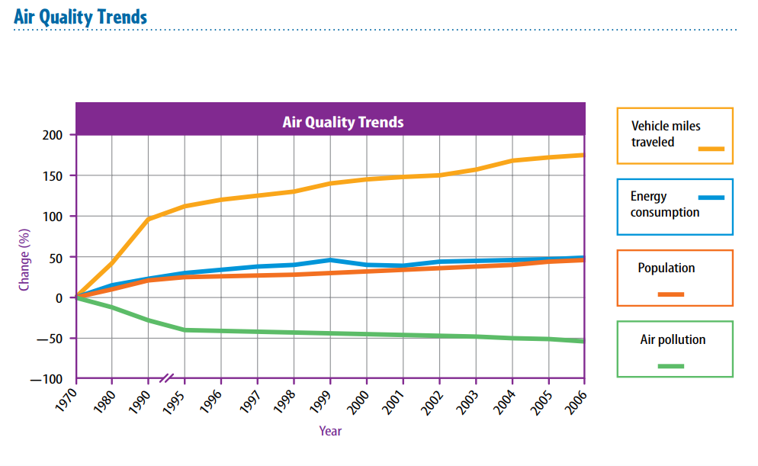
10-3-18 Wednesday 4 min Warm Up
How does air quality change by years?(Check air pollution)

Slide 2
Today Agenda
1) Warm up 4 min
2) Content Practice 10 min
3) Video 10 min
4) Plicker 20 min
Reminder; Tomorrow Open Notebook Quiz on Air Quality
STEM FAIR STEP 1 due is tomorrow
Weekly Homework due is tomorrow.

Slide 3
Content Practice A (page 69)
1. respiratory
2. nonpoint
3. smog
4. sulfur dioxide
5. marsh bacteria
6. thousand
7. smallest
8. inversion
9. Clean Air
10. maroon

Slide 4
Content Practice B (page 70)
1. A point source is identifiable source, such as a factory. A nonpoint source is spread out, such as all the cars in a city.
2.At ground level, ozone can damage the tissues of humans, plants, and animals.
3. Sunlight interacting chemicals
4.Temperature inversion .
5. good—green; moderate—yellow; unhealthy for some groups—orange; unhealthy—red; very unhealthy—purple; hazardous—maroon

Slide 5
Video- Air
http://itsourair.org/3-1-scientific-literacy-and-air-quality

Slide 6
Plicker

