Slide 1
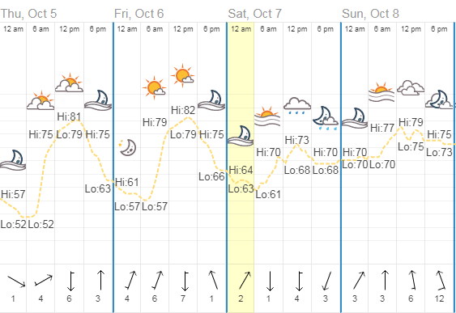
Homework Check
1) Most of my predictions were correct. I recognized the front on the first day was likely to cause significant rainfall. My predictions for the second day were incorrect. I thought the rain would pass through quickly after the cold front arrived. (Sample Answer)

Slide 2
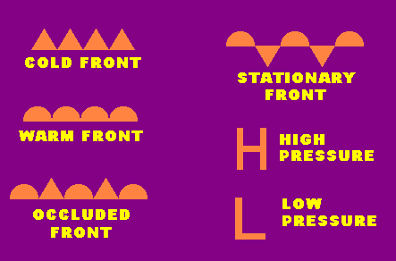
Warm Up 5 minutes 10-9-17 Monday
1) What are the meaning of these symbols.

Slide 3
Today Agenda
1) Warm Up/Homework Check 10 minutes
2) STEM Fair Reminder STEP 2 Background Research. 3 minutes (class dojo)
3) Station Activity-Video 25 minutes
4) Weather Map- Quizlet 7 minutes

Slide 4
STEP 2-3 minutes
1) There is a schology platform you can upload your information.
2) You have schology account from computer classroom.
3) Use same account here is the classroom code;
Access Code
Z9VW4-33775
4) Complete the assignment.
Now everyone go to classdojo.
Click log in then pick student
Wait for the scan code.

Slide 5
Weather Map-25 minutes
1) Video
2) Station Activity
In the station activity there will be seven stations. You are going to answer question for each station on a piece of paper with your group member names.
You have 3 minutes to complete each station.
Good Luck.

Slide 6
Weather Forecast 1
Weather Situation
Questions to answer
A high pressure system moves into North Carolina.
Temperatures, before, were at around 85⁰F.
What will the skies begin to look like after the high pressure system moves in?
Predict what the temperatures will be.
What season will the weather be most like?

Slide 7
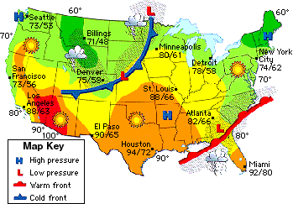
Weather Forecast 2
What kind of front is near North and South Carolina?
What type of pressure system is covering South Carolina?
What kind of weather is South Carolina experiencing?

Slide 8
Weather Forecast 3
Name two cities that have high pressure systems near them.
Name two cities that can expect temperatures over 90⁰F.
What kind of weather is Denver, Colorado having?
What kind of front and pressure system are near Denver, Colorado?

Slide 9
Weather Forecast 4
Situation
Questions to Answer
A low pressure system has moved into Virginia.
A high pressure system also moves into Virginia.
Temperatures are high and the air is very humid.
What kind of weather can Virginia expect?
Will the weather be severe?
Why are temperatures high and the air is humid? Name reasons for these.

Slide 10
Weather Forecast 5
Situation
Questions to answer
There is a 80% chance of rain in Bessemer City.
Temperatures have been warmer.
The humidity has become high.
What type of pressure system has moved into Bessemer City?
Why is the humidity high?
Do you enjoy this kind of weather? Why or why not?

Slide 11
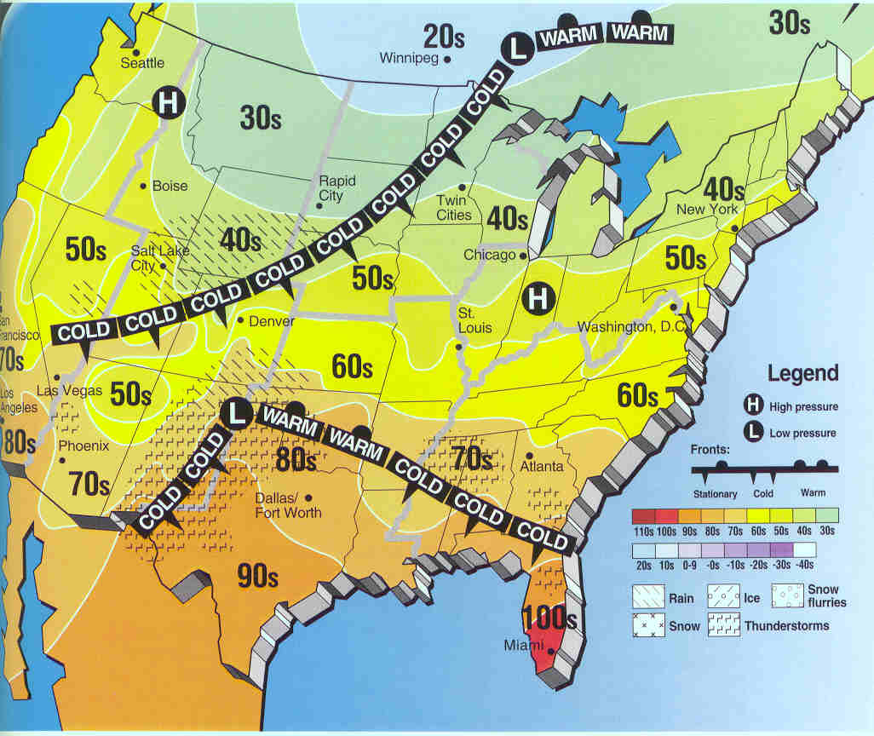
Weather Forecast 6
What kind of weather is Salt Lake City, Utah experiencing? What kind of front is there?
What state has the highest temperatures?
Name the city closest to Bessemer City that is experiencing precipitation.
Name a northern city that is near a high pressure system.

Slide 12
Weather Forecast 7
Situation
Questions to answer
A city has been experiencing rain, high winds, and storms for the past two days.
Temperatures have been higher for the past two days.
What kind of front or air mass has moved into that city?
Why are they experiencing high winds?
What kind of pressure system has moved in that creates higher temperatures and the weather mentioned?

