Slide 1
Warm Up 4 min 10/31/18 Wednesday
Draw the four main steps of mitosis in order.

Slide 2
Today Agenda
1) Warm Up 4 min
2) Quizlet 30 min
3) Quizlet live 10 min
Reminder; STEM FAIR STEP 3 (Hypothesis and Variables)

Slide 3
Quizlet.com
1) Go to my website and click the link for quizlet.com and register your designated classroom.
2) You have an assignment about cell cycle and cell division (Mitosis)
3)

Slide 4
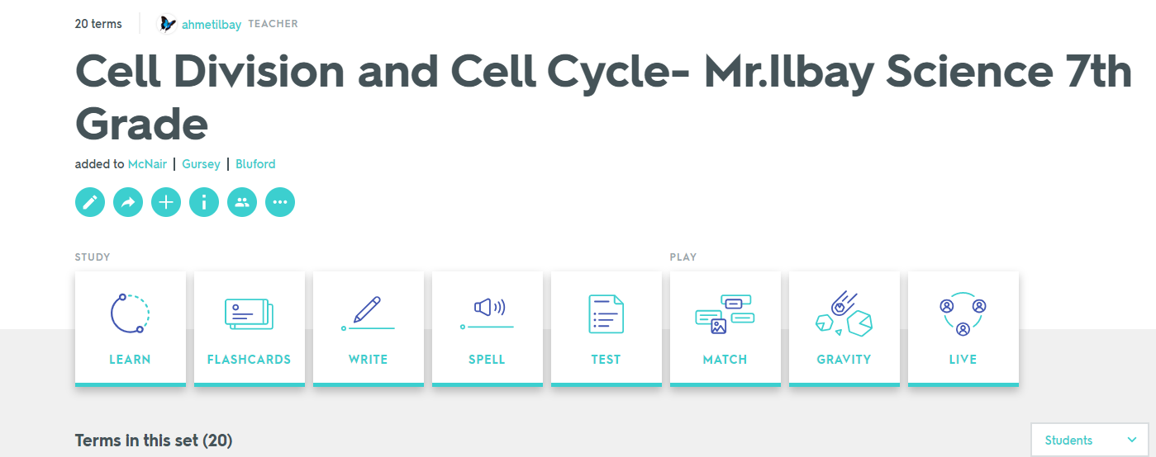
You will practice learn, flashcard and take your vocabulary quiz on quizlet. Show me your score when you are done.

Slide 5
Quizlet Live
Price will given to winner team. Team of 3 or 4 based on the number of the students.

