Slide 1
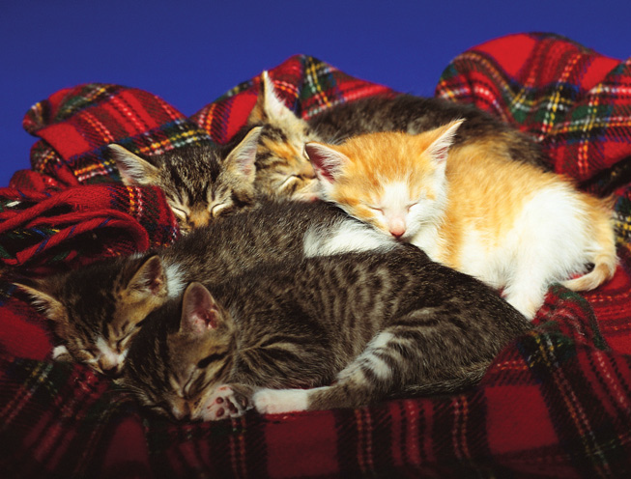
Warm Up 5 minutes 11/13/17
Stripes of a Different Color
As these kittens prove,
brothers and sisters can look
very different from one another.
And although the kittens
resemble their parents, they are
not exact copies of them. Every
cat is unique!
1) Compare the kittens shown
here. How are they alike? How
are they different?
2) What do you think the
parents of these kittens look
like? Discuss.
3) How do brothers, sisters, and
parents compare in human
families?

Slide 2
Warm Up Answer
1)All the kittens appear to be around the same age, have the same size and body shape, and have striped fur. They differ in that the patterns of their fur vary, and most are gray while one is orange.
2 Accept all reasonable answers. It is possible that one parent has gray and white stripes, and the other has orange and white stripes.
3 Like families of cats, human families have members who resemble one another in some ways but differ in other ways.

Slide 3
Today Agenda
1) Warm Up 5 minutes
2) Chapter Introduction-Cellular Reproduction
3) Kahoot/Quizlet

Slide 4
Reproduction of Organisms
Chapter Introduction
Lesson 1: Sexual Reproduction and Meiosis
Lesson 2: Asexual Reproduction
Chapter Wrap-Up

Slide 5
Reproduction of Organisms
Why do living things reproduce?

Slide 6
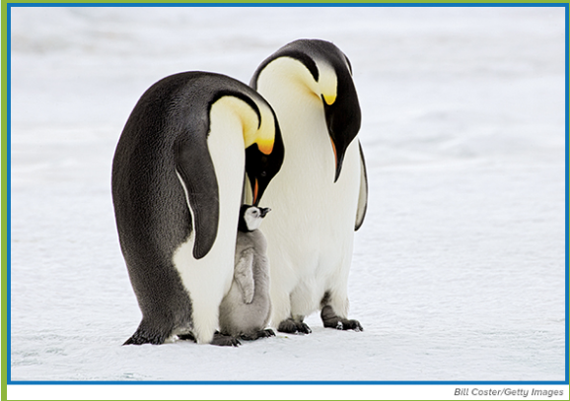
Reproduction of Organisms
Time to bond?
Look at the photo at the beginning of the chapter. Have you ever seen a family of animals, such as the one of penguins shown here? Notice the baby penguin beside its parents. Like all living things, penguins reproduce.
Do you think all living things have two parents?
What might happen if the penguins did not reproduce?
Why do living things reproduce?

Slide 7
Reproduction of Organisms
Why do living things reproduce?
Reproduction ensures the survival of species.

Slide 8
Reproduction of Organisms
Lesson 1: Sexual Reproduction and Meiosis
Sexual reproduction is the production of an offspring from the joining of a sperm and an egg.
Division of the nucleus and cytokinesis happens twice in meiosis. Meiosis I separates homologous chromosomes. Meiosis II separates sister chromatids.
Meiosis maintains the chromosome number of a species from one generation to the next.

Slide 9
Reproduction of Organisms
Lesson 2: Asexual Reproduction
Asexual reproduction is the production of offspring by one parent, which results in offspring that are genetically identical to the parent.
Types of asexual reproduction include fission, mitotic cell division, budding, regeneration, vegetative reproduction, and cloning.
Asexual reproduction is advantageous because it enables some organisms to rapidly produce a large number of offspring in a short amount of time.

Slide 10
Quizlet/Kahoot
https://quizlet.com/189023098/sexual-reproduction-flash-cards/

