Slide 1
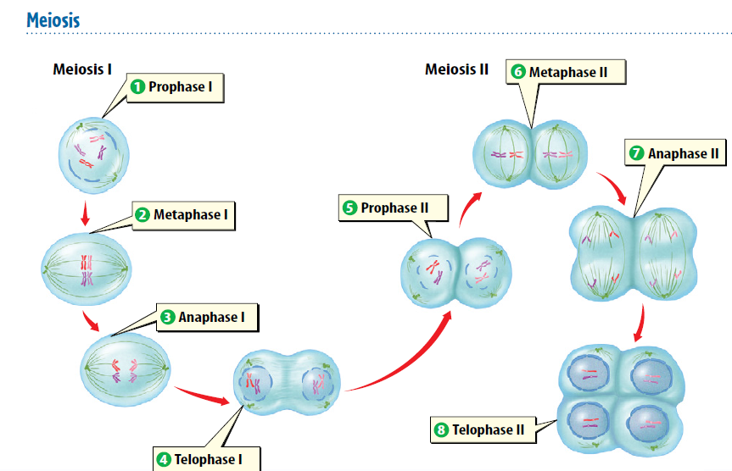
Warm up 5 minutes11/14/17 Tuesday-
Write it down the steps of meiosis.

Slide 2
Today Agenda
1) Warm Up 5 minutes
2) Lesson 1 introduction
3) Content Vocabulary
4) Video- Lesson Outline
5) Homework- STEM FAIR STEP 5

Slide 3
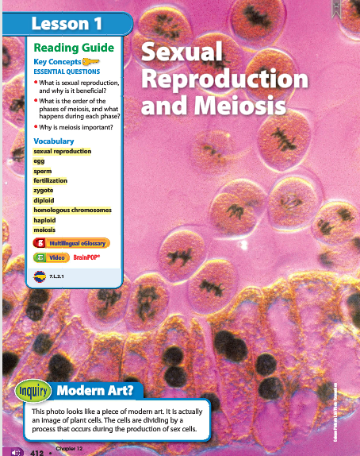
1
Sexual Reproduction and Meiosis
Modern Art?
Look at the photo at the beginning of the lesson. This photo looks like a piece of modern art. It is actually an image of plant cells. The cells are dividing by a process that occurs during the production of sex cells.

Slide 4
1
Sexual Reproduction and Meiosis
Do you agree or disagree?
Humans produce two types of cells: body cells and sex cells.
Environmental factors can cause variation among individuals.
Two parents always produce the best offspring.
Answer;
1) Agree.
2) Disagree. Variation is caused by different genetic factors that each parent organism contributes to an offspring.
3) Disagree. Organisms that reproduce asexually produce healthy offspring

Slide 5
1
Sexual Reproduction and Meiosis
What is sexual reproduction, and why is it beneficial?
What is the order of the phases of meiosis, and what happens during each phase?
Why is meiosis important?
Answer;
1) Sexual reproduction is the production of an offspring from the joining of a sperm and an egg.
2) Division of the nucleus and cytokinesis happens twice in meiosis. Meiosis I separates homologous chromosomes. Meiosis II separates sister chromatids.
3) Meiosis maintains the chromosome number of a species from one generation to the next

Slide 6
1
Sexual Reproduction and Meiosis
sexual reproduction
egg
sperm
fertilization
zygote
diploid
homologous chromosomes
haploid
meiosis

Slide 7
Lesson Vocabulary
1.The egg is the female sex cell, and the sperm is the male sex cell.
2. Fertilization is the joining of the egg and sperm that produces a zygote, which will develop into a new organism.
3. Haploid cells, like sex cells, have only one set of chromosomes. Diploid cells, like most body cells, have pairs of chromosomes.
4. Sexual reproduction involves putting together the DNA of two different sex cells through fertilization.
5. A diploid cell has homologous chromosomes, or pairs of chromosomes—one from each parent.
6. Meiosis separates pairs of homologous chromosomes, which are made of DNA, resulting in haploid cells.
7. Meiosis begins with one diploid cell and produces four haploid cells.

Slide 8
Lesson 1-Outline
Please with the presentation fill out the lesson outline
Part 1
Part 1 – Video
Part 2
Part 2 Video

Slide 9
Homework
STEM FAIR STEP 5

