Slide 1
Warm Up 11-18-16 5 minutes
Compare the role of tumor suppressor genes to proto-oncogenes.
What are HeLa cells and why are they important?
What is the relationship between carcinogens and mutations? How does this in turn affect the development of cancer?

Slide 2
Answer
1)Proto-oncogenes; start cell division
Tumor-suppressor genes which turn off cell division
2) HeLa cells is an immortal line of cell named after Henrietta Lack a female with cervical cancer. (Too many research done with this cell)
3) Carcinogens are cancer causing agents that induce mutations in cells

Slide 3
Today Agenda
1) Warm Up (5 minutes)
2) Instruction time
3) Video
4) Review

Slide 4
Page 390
1) Cell Cycle; The life cycle of a cell is called cell cycle.
2) Chromosomes; the DNA of a cell is organized into structures called chromosomes.

Slide 5
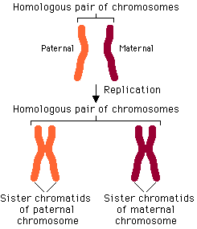
Page 391
Homologous Chromosomes; chromosomes that have the same sequences of genes and same structure.
Mitosis; The complicated process of chromosome separation is called mitosis.

Slide 6
Page 392
Cytokinesis; the division of the cytoplasm of a cell .

Slide 7
Page 393
Summary
1) A cell produces more cells by first copying its DNA.
2) Eukaryotic cells produce more cells through the four phases of mitosis.
3) Mitosis produces two cells that have the same number of chromosomes as the parent cell .

Slide 8
416-Meiosis
Meiosis: is a copying process that produces cells with half the usual number of chromosomes.

Slide 9
Essential Question
What is sexual reproduction?
In sexual reproduction, two parent cells join together to form offspring that are different form both parents.
What are Gametes?
Gametes refer to the reproductive cells that are mainly responsible for reproduction.

Slide 10
Essential Question
What is fertilization? and why is it important?(Genetic diversity)
Fertilization is the union of two dissimilar sexual reproductive units called gametes (n).
Significance of fertilization: The following are the significances performed due to the union (fusion) of male and female gametes (n + n):
Sperm and eggs each only have 23 chromosomes. a full human cell requires 46. Therefore, 23 chromosomes from the dad and 23 chromosomes from the mom = 46 total chromosomes. that's why you're half dad, half mom when it comes to genetic makeup.

