Slide 1
BELL WORK 5 minutes 11/20/17 Monday

Slide 2
ANSWERS WARM UP
1)The photo shows leaves and stems above the water and roots attached to the stem in the water.
2 The newer roots are the thin, light colored roots. The older roots are brown. All the roots are growing from the section of stem in the water.
3 For some plants, small sections of tissue can form successful cuttings. Most plants, however, will not grow from only a piece of a leaf or a root.

Slide 3
Today Agenda
1) Warm Up 5 minutes
2) Lesson 2 Introduction 5 minutes
3) Vocabulary- 5 minutes
4) Project Based Learning (PBL)- 30 minutes
5) Exit Ticket
Reminder;
Homework; STEM FAIR STEP 5 Data Analyze
Student Individual Progress Report will given today. Student who bring it tomorrow with parent signature will get 100 on participation grade.

Slide 4
Lesson 2 Asexual Reproduction
You are going to take notes with slide show. Please get ready a piece of paper and pencil. Keeping regular science journal strongly recommended.

Slide 5
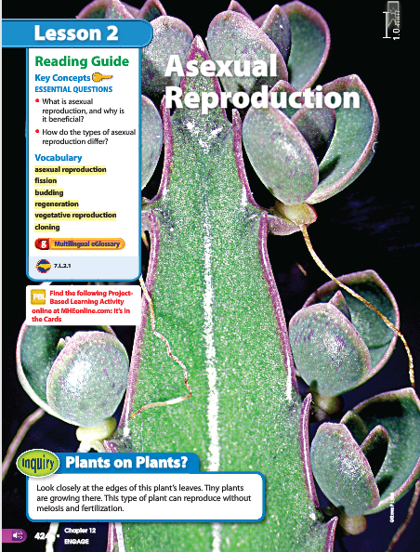
2
Asexual Reproduction
Plants on Plants?
Look at the photo at the beginning of the lesson. Look closely at the edges of this plant’s leaves. Tiny plants are growing there. This type of plant can reproduce without meiosis and fertilization.

Slide 6
2
Asexual Reproduction
Do you agree or disagree?
Cloning produces identical individuals from one cell.
All organisms have two parents.
Asexual reproduction occurs only in microorganisms.
Answer;
1) Agree
2) Disagree. Organisms that have been produced asexually have just one parent.
3) Disagree. Asexual reproduction occurs in unicellular and multicellular organisms
.

Slide 7
2
Asexual Reproduction
What is asexual reproduction, and why is it beneficial?
How do the types of asexual reproduction differ?

Slide 8
Key Concept Answer
a) Asexual reproduction is the production of offspring by one parent, which results in offspring that are genetically identical to the parent.
b) Asexual reproduction is advantageous because it enables some organisms to rapidly produce a large number of offspring in a short amount of time.
2) Type of asexual reproduction
Fission,
budding ,
vegetative reproduction,;
Cloning
Regeneration

Slide 9
2
Asexual Reproduction
asexual reproduction
Budding
Cloning
Fission
regeneration
vegetative reproduction

Slide 10
Vocabulary Definition
asexual reproduction: a form of reproduction in which one parent organism produces offspring without meiosis and fertilization
budding: a form of asexual reproduction that occurs when a new organism grows by mitosis and cell division on the body of its parent
cloning: a type of asexual reproduction performed in a laboratory that produces identical individuals from a cell or from a cluster of cells taken from a multicellular organism
fission: cell division in prokaryotes that forms two genetically identical cells
regeneration: a form of asexual reproduction that occurs when an offspring grows from a piece of its parent
vegetative reproduction: a form of asexual reproduction in which offspring grow from a part of a parent plant

Slide 11
Project Based Learning
Project Overview
Why does the puppy look different from its mother? Do all offspring look different from their parents? A scientific toy company has asked your students to develop and test a card game that models the differences in offspring produced through asexual and sexual reproduction.
The goals of the game are for players to correctly match alien offspring with their parent(s), identify whether the offspring are the result of sexual or asexual reproduction, and then justify their choices.
• Students will develop a card game to model differences in offspring that are produced by asexual reproduction and offspring that are produced by sexual reproduction.
• Students will test their card game and determine how to improve it

Slide 12
Rules
Have students work in pairs.
• Allow 2 class periods for this activity.
You are going to create an account on quizlet and join my classroom.
Every Student need one chromebook.
• Plan on about 20 cards per group.
https://quizlet.com/join/uY5Ay5awX Berkeley
https://quizlet.com/join/vJVnm9nHM Bosphorus
https://quizlet.com/join/44V8Muzj7 Caltech
https://quizlet.com/join/Tesps3CVB Texas
https://quizlet.com/join/7DYzyKqEP Umad

Slide 13
Resources
Key Terms to Research
Sexual reproduction
Asexual reproduction
Genetic variation
Key Web Sites
• National Institutes of Health (NIH)
• National Science Foundation (NSF)

Slide 14
Final
1) After you complete you are going to share with the classroom under your account.
2) We are going to play with group each flash card on quizlet.live
3) These is one of the project grade which is affect your grades 20%.

