Slide 1
Warm Up 11-21-16
What is gametes?
What is Zygote?

Slide 2
Answer
Gamete; a mature haploid male or female germ cell to form a zygote.
Zygote; a diploid cell resulting from the fusion of two haploid gametes; a fertilized ovum.

Slide 3
Today Agenda
1) Warm Up 5 minutes
2) Video time (Definition of haploid, diploid) 5 minutes
3) Instruction time 15 minutes (Phases of Meiosis
4) Reading Article (Classwork 15 min)
5) Review Meiosis

Slide 4
Video
Video 1
Video 2

Slide 5
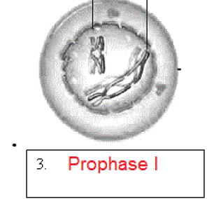
Phase of Meiosis
1) Prophase I
Crossing-over occurs

Slide 6
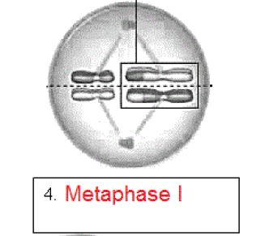
Metaphase I
2) Homologs line up alone equator

Slide 7
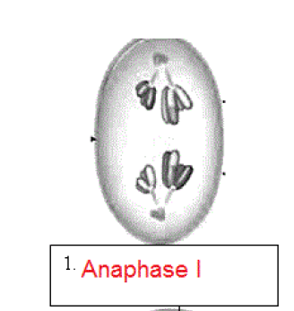
Anaphase 1
Spindle fibers move homologous chromosomes to opposite sides

Slide 8
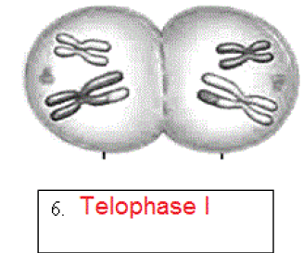
Telophase I
Cytoplasm divides, 2 daughter cells are formed

Slide 9
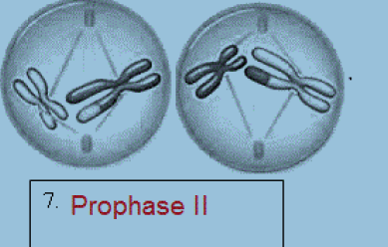
Prophase 2
Homologous chromosomes pair up and form tetrad

Slide 10
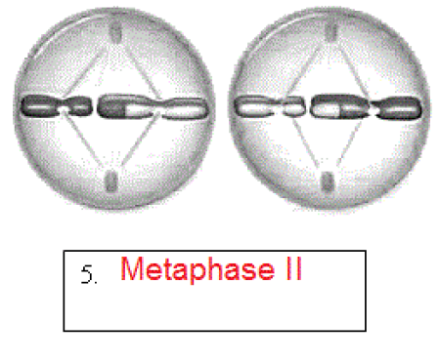
Metaphase II
Chromosomes line up along equator, not in
homologous pairs.

Slide 11
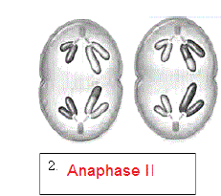
Anaphase II
Chromatids separate

Slide 12
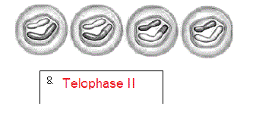
Telophase II
Nuclear membrane reforms, cytoplasm divides, 4 daughter cells formed

Slide 13
Remember the order
I picked my apple today,
Interphase
Prophase
Metaphase
Anaphase
Telophase

