Slide 1
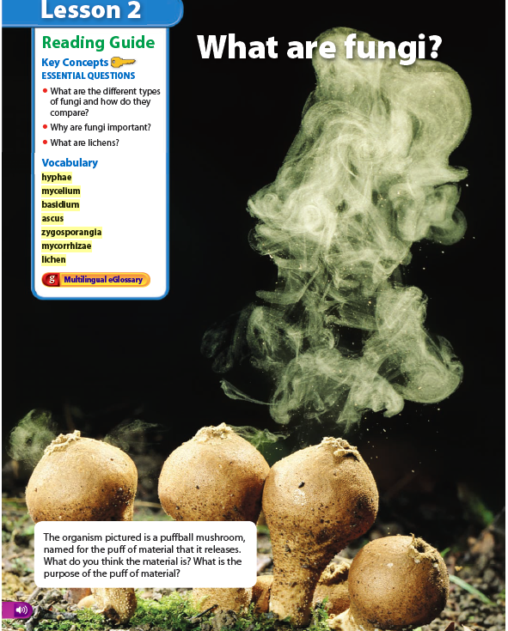
2
Warm Up 5 minutes 11-7-17 Tuesday
Up in Smoke?
Look at the photo at the beginning of the lesson. The organism pictured is a puffball mushroom, named for the puff of material that it releases.
1)What do you think the material is?
2) What is the purpose of the puff of material?

Slide 2
Warm Up Answer
1) The material being released is made up of tiny reproductive cells called spores.
2) Each spores can grow into a new puffball fungus. The spores can be carried by the wind and spread out over a large distance away from the parent fungus.

Slide 3
Today Agenda
1) Warm Up 5 minutes
2) Read to learn/ Lesson outline (10 minutes)
3) Content Practice (10 minutes)
4) Video Quiz (space race)- 10 minutes
5) Brain Pop- Assignment on Chromebook –Fungi(Watch the video and take the quiz)- 10 minutes
6) Homework

Slide 4
Lesson Outline for Teaching-10 minutes
Lesson 2: What are fungi?
A. What are fungi?
1. Fungi, like protists, are eukaryotes.
2. Fungi are heterotrophs, meaning they cannot make their own food.
3. Fungi send out hyphae to find and absorb minerals and water. These threadlike structures form a network, usually underground, called a(n) mycelium.

Slide 5
B. Types of Fungi
1. Scientists sort fungi into four groups, based on how they look and reproduce.
2. Almost all fungi reproduce asexually by producing spores.
3. Mushrooms are the basidiocarps of club fungi.
4. Inside a basidiocarp are the basidia, which are club-shaped reproductive structures that produce sexual spores.
5. The ascus is the reproductive structure where spores develop on sac fungi.

Slide 6
B. Types of Fungi
6. Many yeasts are sac fungi, including the common one used to make bread.
7. Molds are zygote fungi.
8. Tiny stalks called zygosporangia form when a zygote fungus undergoes sexual reproduction.
9. Imperfect fungi have mostly been observed to have asexual reproduction. Scientists reclassify these fungi when they can observe a(n) sexual reproductive stage in the fungus’s life cycle.

Slide 7
C-The Importance of Fungi
1. Fungi play important roles in human food production.
2. Fungi are an important part of the environment because they decompose dead plant and animal matter. They help recycle nutrients.
3. Many fungi and plants grow together, helping each other. The roots and hyphae weave together to form structures called mycorrhizae.
a. Fungi make nutrients available and improve water absorption by roots.
b. Plants make food that the fungi in mycorrhizae can use.
4. Although fungi can cause disease, they are also used to make important medicines.

Slide 8
D. What are lichens?
1. A(n) lichen is a structure formed when fungi and certain photosynthetic organisms grow together.
2. After lichens are established in an area, they improve conditions for other organisms.

Slide 9
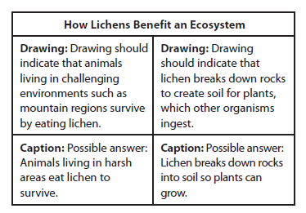
Content Practice A (page 30)
1. provide minerals, provide water, help break down rocks
2. provide sugars, provide oxygen, photosynthesize 3)

Slide 10
Answers continued Content Practice B (page 31)
1. heterotroph
2. hyphae
3. sexually, asexually
4. club fungi, sac fungi, zygote fungi, imperfect fungi
5. basidiocarp
6. Yeast
7. food, matter, pollution, nutrients
8. allergies
9. fungi

Slide 11
Video/Video quiz
Video
Socrative -Space Race

Slide 12
Brain Pop-10 minutes
1)You are going to watch Fungi video and than take the video quiz.
2) You can play with the game after.
Go to BrainPOP or BrainPOP Jr. and click on "Enter Code" at the top.
Enter berkeley7/umad77/caltech7/bosphorus7/texas7
Either log in with their personal accounts or create a new user account. (sign up if you didn’t create an account earlier)
Assignment; Fungi

Slide 13
Direction
Go to BrainPOP or BrainPOP Jr. and click on "Enter Code" at the top.
Enter berkeley7/umad77/caltech7/bosphorus7/texas7
Either log in with their personal accounts or create a new user account. (sign up if you didn’t create an account earlier)
Fungi assignment

Slide 14
Homework
School to home-What are fungi?

