Slide 1
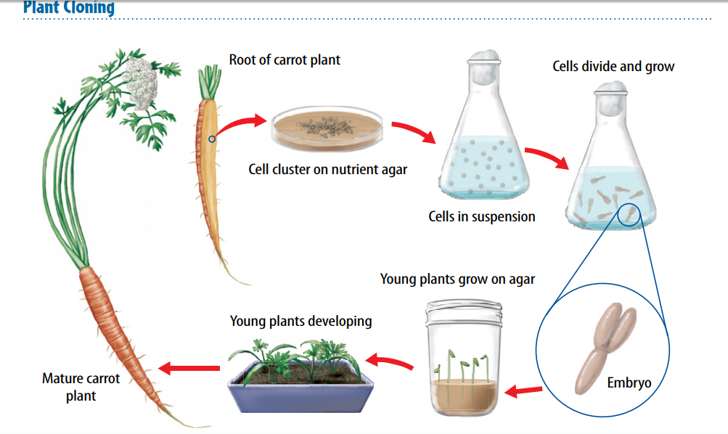
Warm Up 4 min 11/14/18 Wednesday Explain the process of plant cloning

Slide 2
Today Agenda
1) Warm Up 4 min
2) Quizlet (Learn)- Practice( Participation Grade) 20 min
3) Quizizz (Grade on Power School) 20 min

Slide 3
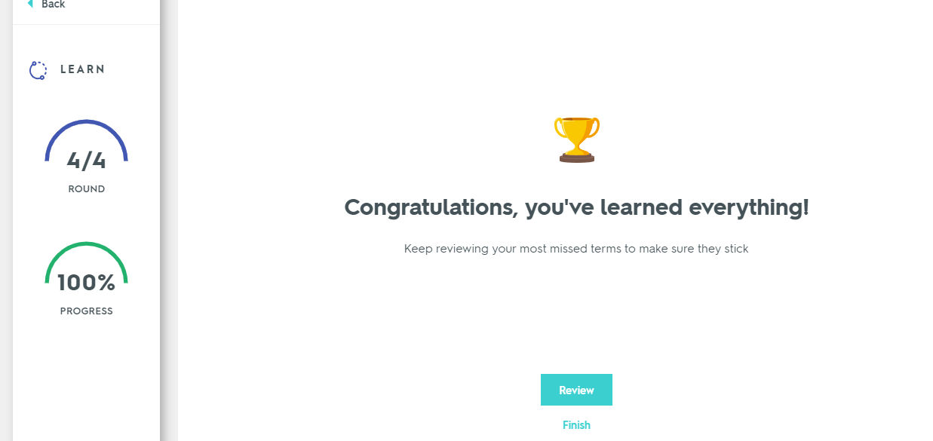
Quizlet (Learn)
Go to www.quizlet.com
Click search button and search:
Lesson 2 asexual reproduction Mr. Ilbay
You will do only learn part of this assignment
Show me your Congratulations screen like in this one get your 100 (participation) – 100 Progress (7 vocabulary mastered)
If you finish before 20 min please go to quizizz.com and wait for the game code (which will be graded)

Slide 4
Quizizz (20 min)
This assignment have 20 question on this independent classwork
Write your first name (if you have same name with someone write your middle initial)
Nickname will get an automatic 0 ( I am not going to bother to find out.
Good luck ( No you cannot rejoin the game you will automatically kick out from the system)
Top three will get some rewards.

