Slide 1
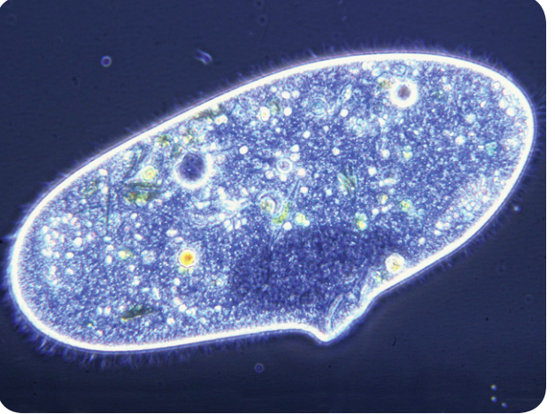
Warm Up 4 min 11/27/18 Tuesday
1) What might you learn about a paramecium by observing it over time?
Answer; Possible answers include learning how the paramecium moves, takes in food, or responds to its environment

Slide 2
Today Agenda
1) Warm Up 4 min
2) Content Practice 10 min
3) Video 5 min
4) Plicker 25 min
Reminder
1) No homework this week due to STEM FAIR STEP 5 Analyze Data
2) STEM FAIR STEP 5 due is 11/30/18 (Friday)
3) STEM FAIR STEP 6 Display Board Presentation and Abstract (12/3/18-12/7/18) Friday is the last day for the Display Board.
Top 10 project between (final score) at 7th grade will go to School Level Stem Fair 12/12/18 3 pm-5 pm at main campus.

Slide 3
Content Practice A (page 13)
1. Protists are eukaryotic organisms that share characteristics with plants, animals, and fungi.
2. Funguslike protists are mostly multicellular organisms that break down organic matter for food.
3. Plantlike protists are unicellular or multicellular organisms that make their own food.
4. Animal-like protists are mostly unicellular and ingest other organisms for nutrients.
5. Student drawings should show a diatom, a dinoflagellate, a euglenoid, or algae.
6. Student drawings should show a paramecium, a flagellate, or a sarcodine.
7. Student drawings should show slime mold or water mold

Slide 4
Content Practice B (page 14)
1. appearance, structures in their cells
2. asexually
3. plantlike, animal-like, funguslike
4. make their own food, unicellular or multicellular
5. ingest other organisms for nutrients, mostly microscopic, all unicellular
6. diatoms, dinoflagellates, euglenoids, algae
7. provide food for animals, provide shelter for aquatic organisms, remove pollution
8. usually microscopic, all unicellular, live mostly in wet environments
9. ciliates, flagellates, scarcodines
10. break down dead animal and plant matter, cause disease
11. break down dead plant and animal matter, attack living plants

Slide 5
Video (Brain Pop) 3;02
https://www.brainpop.com/science/diversityoflife/protozoa/
10 question about the video.

Slide 6
Plicker
10 questions.

