Slide 1
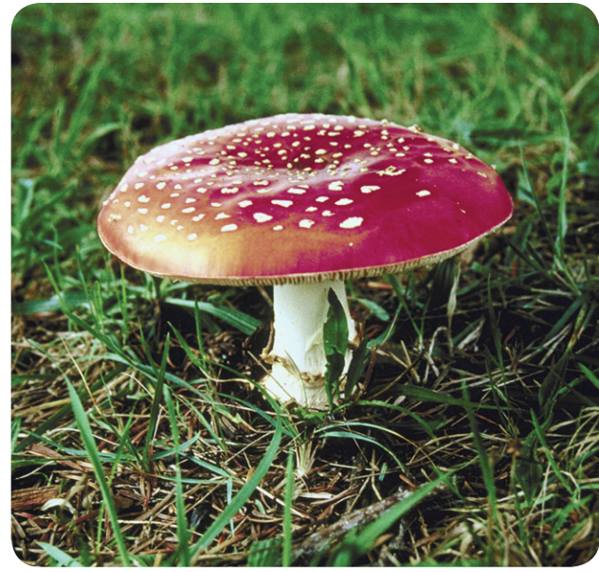
11/30/19 Friday Warm Up 4 min
Mushroom Stories
Picture
1) Part of this mushroom is underground. How do the underground structures of this mushroom help it survive?
2) Where have you seen mushrooms growing? What did they look like?
Answer;
1) The mushroom must have underground parts to anchor it and to take in water and nutrients.
2) Mushrooms can have a variety of shapes, colors, and appearances. They typically are found on lawns, forest floors, and tree bark. Most mushrooms have a stalk and cap.

Slide 2
Today Agenda
1) Warm Up 4 min
2) Brain Pop 30 min
3) Kahoot/ Quizlet Live 10 min
Reminder
STEM FAIR STEP 5 Due is today
STEM FAIR STEP 6 due is next Friday (don’t wait last minute or day to present your display board)
12/19/18 Chapter Test

Slide 3
Brain PoP
There are 10 assignments and due is next Friday. You better plan to finish this accordingly. 12/7/18 Each item is worth 10 points.
Protists Movie
Protists Movie Quiz (graded)
Sortify: Tree of Life Game
Protozoa Movie
Protozoa Movie Quiz (graded)
Algae Movie
Algae Movie Quiz (graded)
Six Kingdoms Movie
Six Kingdoms Movie Quiz (graded)
Six Kingdoms Challenge (graded)

Slide 4
Kahoot/ Quizlet Live
https://play.kahoot.it/#/?quizId=e5c1839f-ba57-4448-b537-62cf004671cb
https://quizlet.com/342851748/chapter-10-protist-and-fungi-mr-ilbay-flash-cards/

