Slide 1
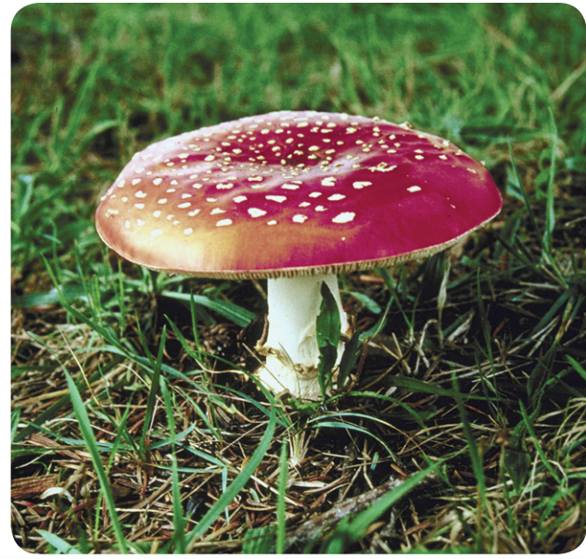
11/29/18 Thursday Warm Up 4 min
Mushroom Stories
Picture
Colorful mushrooms often play fanciful roles in stories and legends. They are interesting in real life as well. Many mushrooms, including the one shown here, are poisonous.
1 What parts do you observe in this mushroom?
Answer; The parts include a narrow stalk and a wide, umbrella-shaped cap.

Slide 2
Today Agenda
1) Warm up 4 min
2) Flocabulary Six kingdom 20 min
3) Plicker 20 min

Slide 3
Flocabulary
1) Watch the video 5 min
2) Fill in the blanks 5 min
3) Review 5 min
4) Rap Lyric (Group Activity) 5 min
https://www.flocabulary.com/unit/six-kingdoms/

Slide 4
Plicker
10 questions about the rap video.

