Slide 1
Warm Up 3 minutes 12/11/17 Monday

Slide 2
Warm Up Answer
Answers to Questions
1 All the kittens have similar body sizes and shapes, and their fur is approximately the same length. They differ in their fur colors and markings.
2 The information came from two parents: a mother and a father. The information was contained in the two cells (sperm and egg) that the parents contributed to the kittens.
3 No. Kittens often look very different from their siblings and their parents.

Slide 3
Today Agenda
1) Warm Up 3 minutes
2) Lesson 2 Understanding Inheritance 10 minutes
3) Content Vocabulary 5 minutes
4) STEM FAIR Presentations- 25 minutes

Slide 4
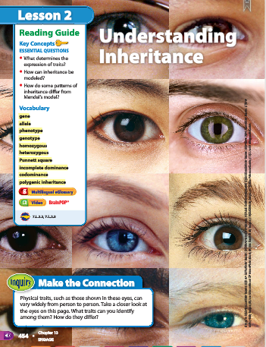
2
Understanding Inheritance- Science Journal
Make the Connection
Look at the photo at the beginning of the lesson. Physical traits, such as those shown in these eyes, can vary widely from person to person. Take a closer look at the eyes on this page.
1)What traits can you identify among them? How do they differ?

Slide 5
2
Understanding Inheritance-Science Journal
Do you agree or disagree?
All inherited traits follow Mendel’s patterns of inheritance.
Scientists have tools to predict the form of a trait an offspring might inherit.
Answer;
1) Disagree. Most genetic traits are not inherited in a Mendelian pattern and have much more complex inheritance pattern
2) Agree

Slide 6
2
Understanding Inheritance-Science Journal
What determines the expression of traits?
How can inheritance be modeled?
How do some patterns of inheritance differ from Mendel’s model?
Answer;
1) Phenotype describes how a trait appears. Genotype describes alleles that control a trait.
2) Punnett squares and pedigrees are tools to model patterns of inheritance.
3) Many patterns of inheritance, such as codominance and polygenic inheritance, are more complex than Mendel described

Slide 7
Content Vocabulary-Lesson 2
allele different form of a gene
codominance occurs when both alleles can be observed in the offspring’s phenotype
conclude to reach a logically necessary end by reasoning
gene section on a chromosome that has genetic information for one trait
genotype two alleles that control the phenotype of a trait
heterozygous having two different alleles of a gene
homozygous having the same two alleles of a gene
incomplete dominance occurs when the offspring’s phenotype is a blend of the parents’ phenotypes
phenotype how a trait appears or is expressed
polygenic inheritance occurs when multiple genes determine the phenotype of a trait
Punnett square model used to predict possible genotypes and phenotypes of offspring

Slide 8
CLASSROOM PRESANTATION
1) You have 3-5 minutes to represent your display board. You will have a grade for presentation (STEP 7 Classroom Presentation)
2) You have to filled it up rubric paper (Name, grade, project name, date and category)
3) Your total point will determine to your final project grade (as a test grade) based on that rubric.

Slide 9
Classroom presentation
The project should include the following elements
Project Title | 0 1 2 3 4 5
Abstract | 0 1 2 3 4 5
Background research | 0 1 2 3 4 5
Hypothesis | 0 1 2 3 4 5
Questions , Variables and Hypothesis | 0 1 2 3 4 5
Material list | 0 1 2 3 4 5
Procedures | 0 1 2 3 4 5
Results, graphs and data | 0 1 2 3 4 5
Conclusion | 0 1 2 3 4 5
Bibliography | 0 1 2 3 4 5
TOTAL ( To convert to 100 point scale: total score x 2)
COMMENTS:

