Slide 1
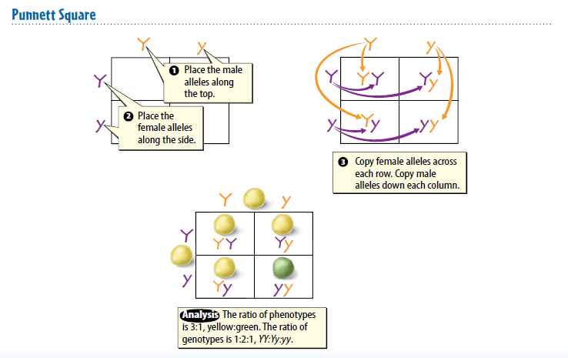
Warm Up 3 minutes 12/12/17 Tuesday Write it down with the square

Slide 2
Today Agenda
1) Warm Up 3 minutes
2) Lesson Outline 10 minutes
3) Video 5 minutes
4) Classroom Presentations 25 minutes

Slide 3
Lesson Outline A. What controls traits?
1. Inside each cell is a nucleus that contains threadlike structures called chromosomes.
2. Mendel’s factors are parts of chromosomes, and each cell in offspring contains chromosomes from both parents.
3. A(n) gene is a section on a chromosome that has genetic information for one trait.
4. The different forms of a gene are called alleles.
5. Geneticists refer to how a trait appears, or is expressed, as the trait’s phenotype.
6. The two alleles that control the phenotype of a trait are called the trait’s genotype.
a. In genetics, uppercase letters represent dominant alleles, and lowercase letters represent recessive alleles.
b. When two alleles of a gene are the same, its genotype is homozygous.
c. If two alleles of a gene are different, its genotype is heterozygous.

Slide 4
B. Modeling Inheritance
1. In a situation based on chance, such as flipping a coin, the chance of getting an outcome can be represented by a(n) ratio such as 50:50, or 1:1.
2. A(n) Punnett square is a model that is used to predict possible genotypes and phenotypes of offspring.
a. To create a Punnett square, you need to know the genotype of both parents.
b. If you count large numbers of offspring from a particular cross, the overall ratio will be close to the ratio predicted by a Punnett square.
3. A(n) pedigree is a diagram that shows phenotypes of genetically related family members. It also gives clues about their genotypes

Slide 5
C. Complex Patterns of Inheritance
1. Alleles show incomplete dominance when the offspring’s phenotype is a blend of the parents’ phenotypes.
2. Alleles show codominance when both alleles can be observed in a phenotype.
3. Unlike the genes in Mendel’s pea plants, some genes have multiple alleles.
4. ABO blood type is a trait that is determined by multiple alleles.
5. Polygenic inheritance occurs when multiple genes determine the phenotype of a trait.
6. Human eye color is an example of polygenic inheritance

Slide 6
D. Genes and the Environment
1. Genes are not the only factors that can affect phenotypes. An organism’s environment can also affect its phenotype.
2. The flower color of one type of hydrangea is determined by the soil in which the hydrangea grows.
3. Healthy choices can affect a person’s phenotype.

Slide 7
Video
Understanding Inheritance
https://www.brainpop.com/science/cellularlifeandgenetics/heredity/
https://www.brainpop.com/health/geneticsgrowthanddevelopment/genetics/
https://www.youtube.com/watch?v=h2xufrHWG3E

Slide 8
CLASSROOM PRESANTATION
1) You have 3-5 minutes to represent your display board. You will have a grade for presentation (STEP 7 Classroom Presentation)
2) You have to filled it up rubric paper (Name, grade, project name, date and category)
3) Your total point will determine to your final project grade (as a test grade) based on that rubric.

Slide 9
Classroom presentation
The project should include the following elements
Project Title | 0 1 2 3 4 5
Abstract | 0 1 2 3 4 5
Background research | 0 1 2 3 4 5
Hypothesis | 0 1 2 3 4 5
Questions , Variables and Hypothesis | 0 1 2 3 4 5
Material list | 0 1 2 3 4 5
Procedures | 0 1 2 3 4 5
Results, graphs and data | 0 1 2 3 4 5
Conclusion | 0 1 2 3 4 5
Bibliography | 0 1 2 3 4 5
TOTAL ( To convert to 100 point scale: total score x 2)
COMMENTS:

