Slide 1
Warm Up 5 minutes 12/5/17 Tuesday Write and draw the hybrid crosses

Slide 2
Today Agenda
1) Warm Up 5 minutes
2) Lesson Outline (Lesson 1) 10 minutes
3) Read to Learn- 10 minutes
4) After you Read(Classwork)- 15 minutes
5) Video-3 minutes

Slide 3
Lesson 1: Mendel and His Peas
A. Early Ideas about Heredity
1. Heredity is the passing of traits from parents to offspring.
2. In the 1850s, Gregor Mendel, an Austrian monk, performed experiments that
helped answer questions about how traits are inherited.
3. Genetics is the study of how traits pass from parents to offspring

Slide 4
B. Mendel’s Experimental Methods
1. Pea plants were ideal for genetic studies because they reproduce quickly; they have easily observed traits; and the experimenter can control which pairs of plants reproduce.
2. Mendel controlled which plants pollinated other plants.
a. When a(n) true-breeding plant self-pollinates, it always produces offspring with traits that match the parent.
b. By cross-pollinating plants himself, Mendel was able to select which plants pollinated other plants.
3. With each cross-pollination Mendel did, he recorded the traits that appeared in the offspring.

Slide 5
C. Mendel’s Results
1. Mendel’s crosses between true-breeding plants with purple flowers produced plants with only purple flowers. Crosses between true-breeding plants with white flowers produced plants with only white flowers.
2. Crosses between true-breeding plants with purple flowers and true-breeding plants with white flowers produced plants with only purple flowers.
3. The first–generation purple-flowering plants are called hybrid plants.
4. When Mendel cross-pollinated two hybrid plants, the trait that had disappeared in the first generation always reappeared in the second generation.
5. Mendel analyzed the data from many experiments on seven different traits. He always noted a 3:1 ratio; for example, purple flowers grew from hybrid crosses three times more often than white flowers.

Slide 6
D. Mendel’s Conclusions
1. After analyzing the results of his experiments, Mendel concluded that two factors control each trait.
2. Mendel also proposed that, when organisms reproduce, each reproductive cell—sperm or egg—contributes one factor for each trait.
3. A genetic factor that blocks another genetic factor is dominant.
4. A genetic factor that is blocked by the presence of a dominant factor is called recessive.
5. For the second generation, Mendel cross-pollinated two hybrids with purple flowers. About 75 percent of the second-generation plants had purple flowers. These plants had at least one dominant factor. Twenty-five percent of the second generation plants had white flowers. These plants had the same two recessive factors.

Slide 7
Read To Learn
1) Reading Check-Define; What is genetic?
The study of how traits are passed from parents to offspring
2. Explain In his breeding experiments, how did Mendel know which traits came from which pair of plants?
He controlled which pairs of plants reproduced

Slide 8
Read to Learn
3. Explain Why did Mendel perform cross-pollination experiments?
To select which plants pollinated other plants, so that he could learn about how traits are passed from parents to offspring
4. Predict the offspring of a cross between two true-breeding pea plants with smooth seeds.
All offspring would have smooth seeds

Slide 9
Read To Learn
5. Use Ratios A science class has 14 girls and 7 boys. Simplify the ratio.
14:7 = 14/7 = 2/1 = 2:1
6. Predict If a cross between two hybrid plants
with purple flowers produced 12 offspring, how many offspring would you expect to have purple flowers?
9

Slide 10
Read To Learn
7. Summarize What did Mendel conclude about inherited traits?
Two factors control each inherited trait—one contributed by the egg and one by the sperm
8. Describe How do dominant and recessive
factors interact?
One dominant factor will block a recessive factor, so the recessive trait will appear in the offspring only if the offspring has two recessive factors.

Slide 11
After You Read- Classwork
You have 15 minutes to complete 13 questions.
Please return last page of the packet so I can grade your work. Thank you.

Slide 12
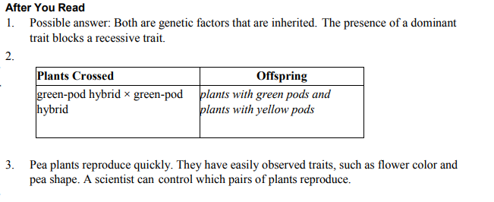
Answer

Slide 13
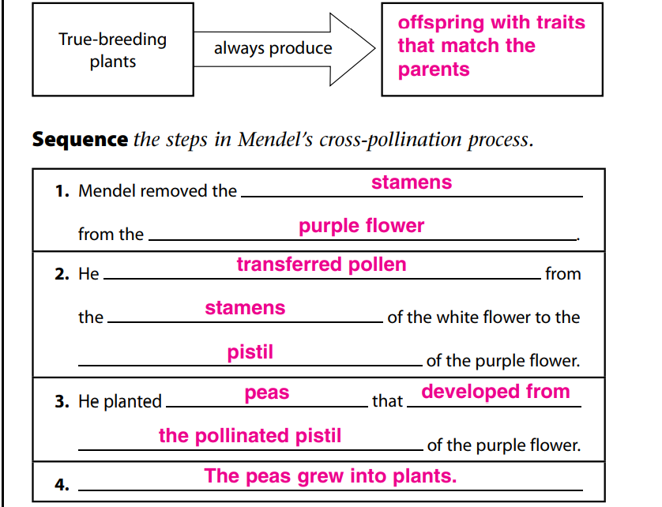
Answer Key

Slide 14
Answer Key

Slide 15
Video
https://www.brainpop.com/science/cellularlifeandgenetics/heredity/

