Slide 1
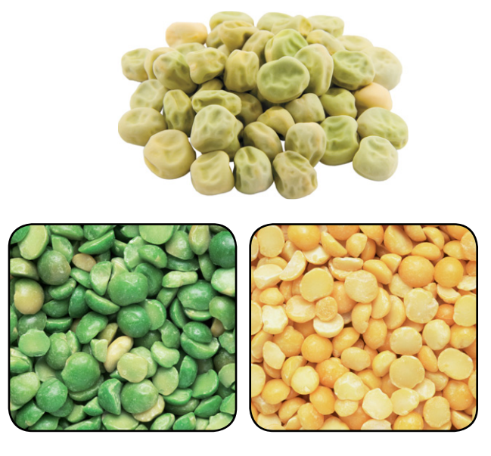
Warm Up 4 min 12/3/18 Monday
Open a bag of frozen peas, and you will likely find that the peas are identical. These peas are the immature seeds of pea plants. In nature, however, mature pea seeds have many differences, as do the plants on which they grow. Peas can be green or yellow, as well as smooth or wrinkled. Pea plants can be tall or short, and their flowers are either purple or white.
Compare the varieties of peas shown here.
Answer; The peas are all approximately the same size and shape. They differ in their color and smoothness.

Slide 2
Today Agenda (44 min)
1) Warm Up 4 min
2) Lesson Outline (Mendel and his peas) 10 min
3) Video 5 min
4) Plicker 20 min
5) Review the topic and results. (5 min)
Reminder
1) This week no homework due to STEP 6 Display Board presentation and final stem fair grade 12.7.18
2) This whole week you can present your display board (Don’t wait last minute or last day please)
3) You will receive a final grade on your project when you present everything (3 min)
4) Top 15 project overall 7th grade will go to school stem fair 12/12/18 3 pm to 5 pm.
5) Chapter Test 12/19/18 right before the winter break. Wednesday.

Slide 3
Lesson Outline Lesson 1: Mendel and His Peas
A. Early Ideas about Heredity
1. Heredity is the passing of traits from parents to offspring.
2. In the 1850s, Gregor Mendel, an Austrian monk, performed experiments that helped answer questions about how traits are inherited.
3. Genetics is the study of how traits pass from parents to offspring.
B. Mendel’s Experimental Methods
1. Pea plants were ideal for genetic studies because they reproduce quickly; they have easily observed traits; and the experimenter can control which pairs of plants
reproduce.
2. Mendel controlled which plants pollinated other plants.
a. When a(n) true-breeding plant self-pollinates, it always produces offspring with
traits that match the parent.
b. By cross-pollinating plants himself, Mendel was able to select which plants
pollinated other plants.
3. With each cross-pollination Mendel did, he recorded the traits that appeared
in the offspring.

Slide 4
C. Mendel’s Results
1. Mendel’s crosses between true-breeding plants with purple flowers produced plants with only purple flowers. Crosses between true-breeding plants with white flowers produced plants with only white flowers.
2. Crosses between true-breeding plants with purple flowers and true-breeding plants with white flowers produced plants with only purple flowers.
3. The first–generation purple-flowering plants are called hybrid plants.
4. When Mendel cross-pollinated two hybrid plants, the trait that had disappeared in the first generation always reappeared in the second generation.
5. Mendel analyzed the data from many experiments on seven different traits. He always noted a 3:1 ratio; for example, purple flowers grew from hybrid crosses three times more often than white flowers.

Slide 5
D. Mendel’s Conclusions
1. After analyzing the results of his experiments, Mendel concluded that two factors control each trait.
2. Mendel also proposed that, when organisms reproduce, each reproductive cell—sperm or egg—contributes one factor for each trait.
3. A genetic factor that blocks another genetic factor is dominant.
4. A genetic factor that is blocked by the presence of a dominant factor is called recessive.
5. For the second generation, Mendel cross-pollinated two hybrids with purple flowers. About 75 percent of the second-generation plants had purple flowers. These plants had at least one dominant factor. Twenty-five percent of the second generation plants had white flowers. These plants had the same two recessive factors.

Slide 6
Video (Mendel and His peas)
3:06 Ted-Ed talks Mendel and Heredity
https://www.youtube.com/watch?v=Mehz7tCxjSE

Slide 7
Plicker
This activity is graded weekly based on the average score of students.
Don’t get upset if you fail or do low performance one of the assignment.

