Slide 1
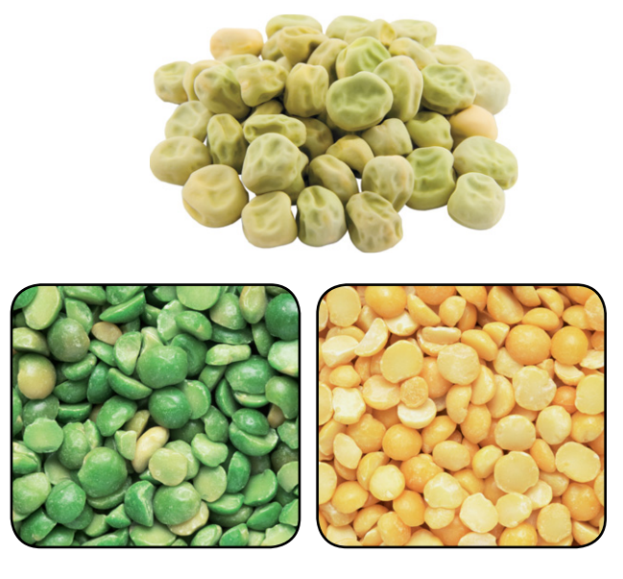
Warm Up 4 min 12/4/18 Tuesday
What other variations are found in plants and animals?
Answer: Varieties of corn have kernels of different colors and size, and they differing sweetness. Apples can be yellow, red, or green , and they have a variety of tastes.

Slide 2
Today Agenda (44 min)
1) Warm Up 4 min
2) Content Practice (Mendel and his peas) 10 min
3) Video 5 min
4) Plicker 20 min
5) Review the topic and results. (5 min)
Reminder
1) This week no homework due to STEP 6 Display Board presentation and final stem fair grade 12.7.18
2) This whole week you can present your display board (Don’t wait last minute or last day please)
3) You will receive a final grade on your project when you present everything (3 min)
4) Top 15 project overall 7th grade will go to school stem fair 12/12/18 3 pm to 5 pm.
5) Chapter Test 12/19/18 right before the winter break. Wednesday.

Slide 3
Content Practice A (page 13)
1. T
2. F
3. F
4. T
5. F
6. T
7. F
8. F
9. T
10. T

Slide 4
Content Practice B (page 14)
1. the study of how traits are passed from parents to offspring
2. They reproduce quickly, they have easily observable traits, and he could control which pairs of plants reproduced.
3. hybrids
4. All the plants had purple flowers.
5. About one-fourth of the plants had white flowers, and about three-fourths had purple flowers.
6. Color of pea-plant flowers and other traits of the plants are determined by two factors- Dominant and recessive.

Slide 5
Video 4;41 min
Gregor Mendel
https://www.youtube.com/watch?v=cWt1RFnWNzk&t=1s

Slide 6
Plicker

