Slide 1
Warm up 4 min 1/3/19 Thursday
What are four main bases in the DNA?
What are the nucleotides made of?
Answer;
adenine (A) and thymine (T) (Bond each other)
guanine (G) Cytosine (C) (Bond each other)
Sugar, Phosphate, nitrogen base

Slide 2
Today Agenda (44 min)
1) Warm Up 4 min
2) Content Practice Lesson 3 DNA and Genetic (10 min)- Practice
3) Quizizz (Classwork- Grade on PowerSchool) 15 min
4) Quizlet (Lesson 3 Vocabulary)- Practice 15 min
Important Reminder;
No homework this week (since it is only two days)
Chapter Test 1/11/19 (Friday)
2nd Quarter Science Benchmark (1/18/19- Test Grade effect 3rd quarter)
Last day of the 2nd quarter 1/17/19 (Thursday)- Fix the grade soon as possible (if you want to go that Charlotte Field Trip , ALL A’s and B’s are eligible only)

Slide 3
Content Practice A (page 51)
1. proteins, DNA
2. traits, genes
3. double helix
4. nucleotides, phosphate, nitrogen
5. replication
6. RNA
7. transcription, translation
8. amino acids
9. mutation
10. genetic disorder

Slide 4
Content Practice B (page 52)
1. DNA and proteins
2. a nitrogen base, a sugar, and a phosphate group
3. replication
4. messenger RNA, transfer RNA, and ribosomal RNA
5. transcription
6. translation
7. deletion mutations, insertion mutations, and substitution mutations.
8. breast cancer, ovarian cancer
9. It can cause a trait to change in a way that benefits the organism.

Slide 5
Quizizz.com (Classwork) 15 min
Lesson 3 - DNA & Genetics Mr. Ilbay ( 15 questions 15 min ) Good luck.
Don’t put your nickname (there will 0 automatically)
You can use your resource
No retake or second login.

Slide 6
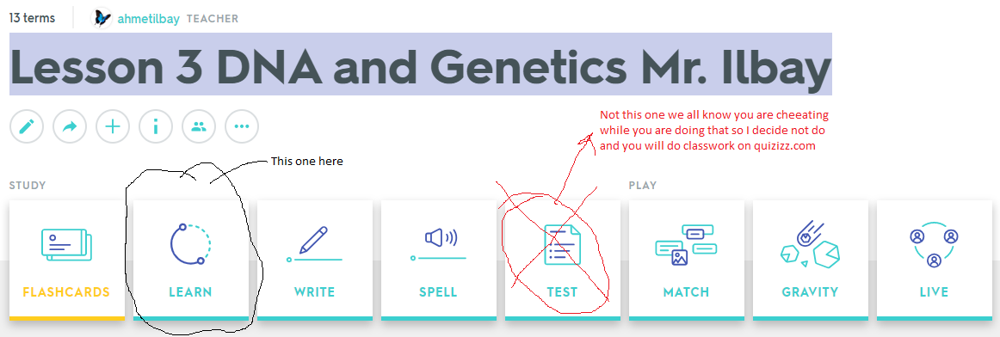
Quizlet
Go to www.quizlet.com
Click search button (don’t try to sign in ) and type Lesson 3 DNA and Genetics Mr. Ilbay
Do Learn part of the assignment and practice

