Slide 1
Warm Up
1)Copy the following notes to your warm up paper.
Today’s Goal: I will know what circulatory system is. I will know the parts and function of the circulatory system.
Get your text book under your desk and open page 176

Slide 2
Today Agenda
1) Warm Up 5 minutes
2) Instruction Time (Page 176-Page 181)
3) Study Jams-Video
4) Brain Pop
5) Homework

Slide 3
Page 176
Cardiovascular System; a collection of organs that transport blood throughout the body
Reading Check; What are the four main parts of the cardiovascular system?
1) Heart
2) Your blood
3) Veins
4) Lymphatic system

Slide 4
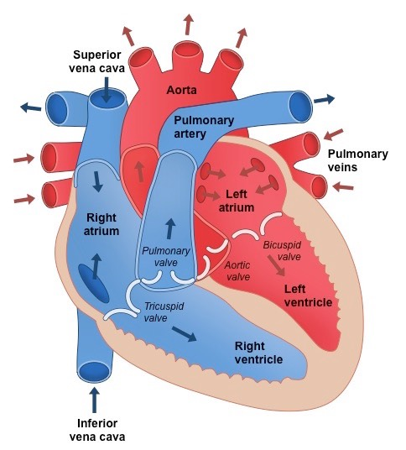
Page 177
The heart;
Upper chamber called atrium
Lower chamber called ventricle
Valves; Flap like structures are located between the atria and ventricles.

Slide 5
Page 178
Artery: A blood vessel that carries blood away from the heart to the body’s organs
Capillary: A tiny blood vessel that allows an exchange between blood and cells in other tissue
Vein; in a biology, a vessel that carries blood to the heart.

Slide 6
Page 179
Pulmonary Circulation; the flow of the blood from the heart to the lungs and back to the heart through the pulmonary arteries, capillaries, and veins.
Systemic circulation: the flow of blood from the heart to all parts of the body and back to the heart

Slide 7
Page 180
Math Practice; 70 heart beat a minute
1 hour =60 minutes
1 day = 24 hours
Calculate how many times a heart beats in a day.
(100800 Beat in a day)
Why is atherosclerosis dangerous?
It can cause vessel blockage and heart attack occurs.

Slide 8
Section Review-Page 181
1) Using Key terms
Explain how the meaning of the terms differ.
Artery= Vessel carry blood away from heart
Vein= Vessel carry blood back to heart
Systemic Circulation; The circulation blood between heart to all body
Pulmonary Circulation; The circulation blood between your heart and lung

Slide 9
Video-Study Jams
Watch the video and you are going to write the summary of the video.

Slide 10
Brain Pop
1) Circulatory System Label it
2) Circulatory System Quiz

Slide 11
Homework

