Slide 1
Warm Up 5 minutes
What is the speed of a kayak traveling 100 meters in 140 seconds?
0.71m/s
2)Calculate the speed of an armadillo running through a yard covering 24 meters in 52
seconds.
0.46 m/s

Slide 2
Today Agenda
1) Warm up 5 minutes/ Homework collection
2) Instruction time
3) Classwork
4) Chromebook Ck12- Khan Academy
6) Exit Ticket

Slide 3
Write it down to your science journal

Slide 4
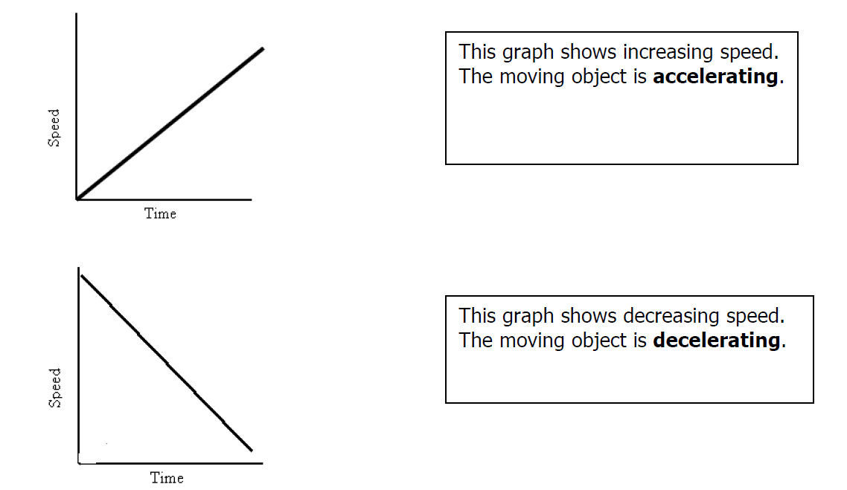
Write it down to your science journal

Slide 5
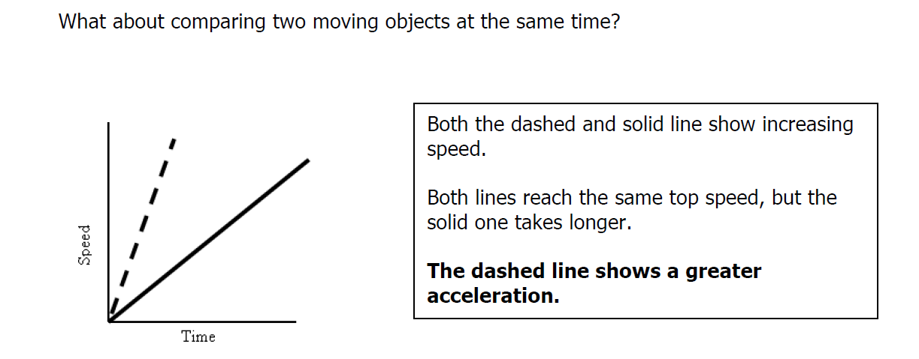
Write it down to your science journal

Slide 6
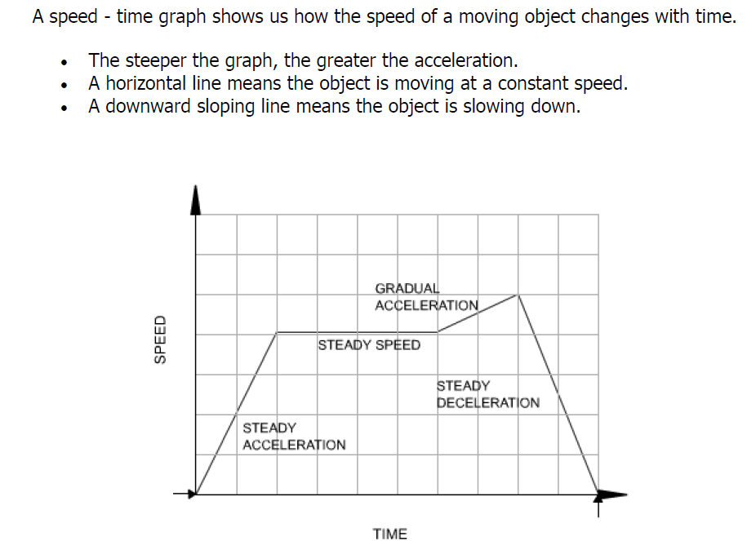
Summary

Slide 7
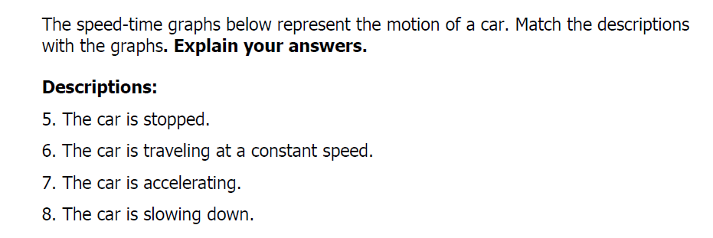
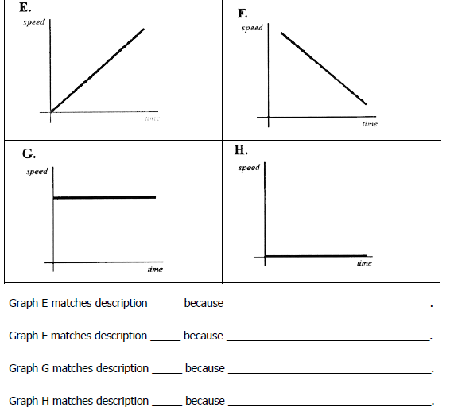

Slide 8
Practice Time
CK12
Usermame= Yournametmsa
Password; tmsa2017
Khan Academy

Slide 9
Exit Ticket
Go to www.socrative.com
Student Login
Room Name; TMSACOMPUTER
Your last name, first name
Teacher question ; what is the difference between constant speed graph , accelerated speed graph?

