Slide 1
Warm Up 5 minutes 3-29-17
1) What is the quantities is in the
denominator of the units for acceleration?
time squared
2) If an object is moving at a constant velocity, it means that __________.
no net force is acting on it

Slide 2
Today Agenda
1) Warm Up 5 minutes
2) Flocabulary Motion fill in the blanks 5 minutes
3) Quick review 5 minutes
4) Flocabulary question 10 minutes
5) Chapter Review 5 minutes
6) Bill Nye the Science Guy 20 minutes

Slide 3
Flocabulary
Motion
Motion fill in the blanks
Quiz

Slide 4
Study Guide
1) What is motion?
A change in position of an object is its
2) What is difference between speed and velocity?
Speed; distance and direction are quantites
Velocity; The speed and direction of an object's motion.

Slide 5
Study Guide
3) What's the relationship between acceleration and velocity?
Speeding up, slowing down, or changing direction are all examples of acceleration.
Acceleration is a change in velocity.
units for acceleration= time squared

Slide 6
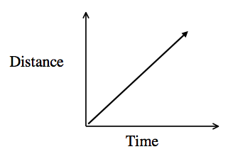
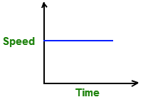
Study Guide
4)
5)

Slide 7
Study Guide
6) What causes a change in velocity?
Velocity consists of a direction and a speed. So if you have a change in direction and/or a change in speed the velocity will change.

Slide 8
Review Question
1) Which level of the atmosphere is the hottest?
thermosphere
2) What type of cloud is white and fluffy like a cotton ball?
Cumulous
3) Which of the following is not part of the cell
theory?
all cells have nuclei
4) If a microscope has an ocular lens of x4 and you
are using the x40 objective, what is your total magnification?
400

Slide 9
Bill Nye Science Guy –Motion
Worksheet-
Quizlet Review

