Slide 1
3/14/19 Thursday 4 min Warm Up
What are disorders of nervous system?
Answer
Alzheimer's disease, Parkinson's disease, epilepsy, and stroke are common nervous system disorders.

Slide 2
Today Agenda
1) Warm Up 4 min
2) Guided Practice 10 min
3) Video 15 min
4) Plicker 20 min
Important Reminder
1) Weekly Homework Nervous System is this Friday
2) Student Group Presentation is Friday(Samuel, Fouziah, Malachi, Dayana, Marius)
3) Control System Quiz Next Friday 3/22/19
4) Unit Test and Last Day of Q3 is 3/28/19 Thursday

Slide 3
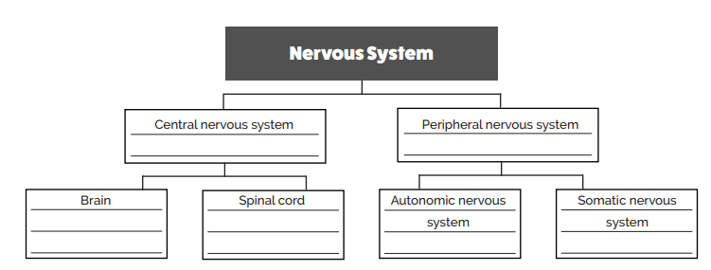
Practice Answer- Part A

Slide 4
Video- Brain Pop 15 min
1) Nervous System
2) Brain
3) Spinal Cord
4) Neurons

Slide 5
Plicker
15 questions.

