Slide 1
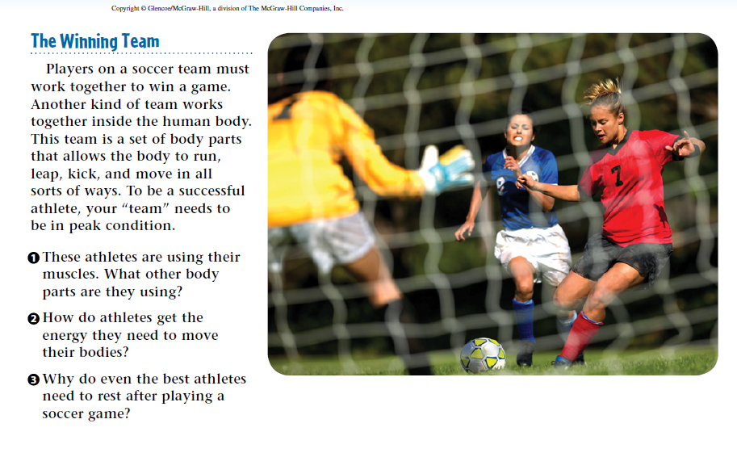
Warm Up 3 min 3/25/19 Monday

Slide 2
Warm Up Answer
1) the lungs (breathing air), heart
(pumping blood), eyes (observing the ball and
the other players).
2) Food provides this energy. The digestive system
breaks down food, and the body then stores energy to use when it is needed.
3) The muscles, heart, and lungs work very hard
during a soccer game and use large amounts of
energy.

Slide 3
Today Agenda- 43 min
1) Warm Up 3 min
2) Quizlet Human Body System Practice 30 min
3) Quizizz Human Body System Practice 10 min
Important Reminder
No weekly homework but study guide
Unit Test on Thursday
Last day of 3rd Quarter is Thursday no school on Friday.

Slide 4
Quizlet- 30 min
1) Go to www.quizlet.com
2) You search The Human Body Systems- TMSA
3) You study the flashcard, learn for practice
4) You finish the practice you can go to www.quizizz.com and wait for the code (Vocab Quiz)

Slide 5
Quizizz- 10 min
1) 20 questions (10 human body system) 2 questions of each.
2) You have total 10 minutes) .

