Slide 1
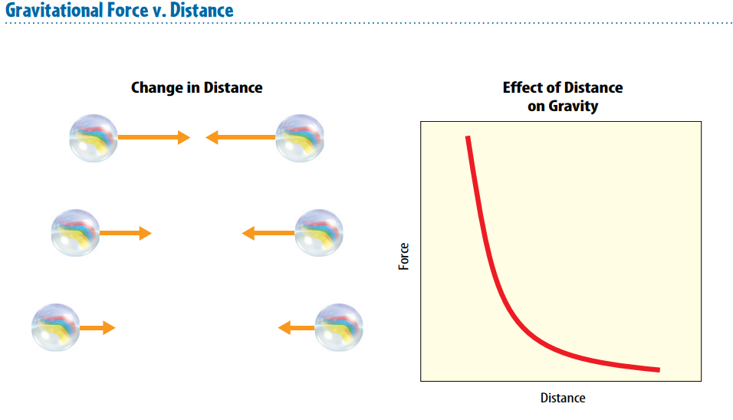
4/10/18 Tuesday 5 min

Slide 2
Today Agenda 47 min
1) Warm Up 3 minutes
2) Lesson Vocabulary 10 min
3) Lesson outline 15 min
4) Content Practice 15 min
5) Video ( 5 min)
6) Homework (Newton’s Life)

Slide 3
Content Vocabulary
1. friction
2. weight
3. gravity
4. static
5. significant
6. mass
7. contact force
8. force
9. noncontact force

Slide 4
Lesson Outline 3 min
A. Types of Forces
1. A push or a pull is called a(n) force.
2. A(n) contact force is a push or a pull on an object by another object that is touching it.
3. A force that one object can apply to another object without touching it is a(n) noncontact force.
4. Gravity, magnetism, and electric forces are examples of noncontact forces.
5. Forces have strength and direction.
6. An arrow can be used to show a force; the length shows the strength of the force, and the direction of the arrow shows the direction of the force.
7. Forces are measured in units called newtons.

Slide 5
B. What is gravity?- 3 min
1. Mass is the amount of matter in an object. 2. Gravity is an attractive force that exists between all objects that have mass.
3. Mass is often measured in kilograms.
4. According to the law of universal gravitation, all objects are attracted to one another with a gravitational force that is proportional to the mass of the objects and the distance between them

Slide 6
B. What is gravity?- 3 min
a. When the mass of one or both objects increases, the gravitational force between the objects increases.
b. When the distance between two objects increases, the attraction between the objects decreases.
5. Weight is the gravitational force exerted on an object.
a. Near Earth’s surface, an object’s weight is the gravitational force exerted on the object by Earth.
b. The weight of an object on Earth decreases significantly only when the object moves a great distance away from Earth

Slide 7
C. Friction- 3 min
1. Friction is a force that resists the motion of two surfaces that are touching.
2. Static friction prevents surfaces from sliding past each other.
3. Up to a limit, the strength of static friction changes to match the applied force.
4. Sliding friction opposes the motion of surfaces sliding past each other.
a. When an object is sliding, the force of sliding friction does not change; for this reason, increasing the applied force makes a sliding object move faster.
b. If you stop pushing a sliding object, the object will eventually stop due to sliding friction.

Slide 8
C. Friction- 3 min
5. Fluid friction is friction between a surface and a fluid, such as air or water.
a. Fluid friction between an object and air is called air resistance.
b. Decreasing an object’s surface area by changing its shape decreases the object’s air resistance.
6. One reason for friction between surfaces is the microscopic roughness, or the dips and bumps of one surface that catch on those of the other surface.
7. One reason for friction between surfaces is that atoms and molecules with opposite charges attract each other.
8. Lubricants decrease friction by causing a slight separation between solid surfaces, so they don’t contact each other.

Slide 9
Content Practice A-B 15 min
There are 10 Questions Content A- (50 Point)
There are 7 questions Content B- (70 ) Points
You have 15 minutes to complete and we will check the each other answers.

Slide 10
Video
https://www.youtube.com/watch?v=bkHd6cSz104

Slide 11
Homework
Newton’s Life 8 questions.

