Slide 1
Warm up 5 min 4/16/18 Monday

Slide 2
Warm Up Answer
1.When the ball is hit directly, it travels in the same direction as the foot that strikes it.
2 To make the ball soar, her foot should strike the ball near the ground and move upward as it strikes. 3 Because a football is not round, it often bounces in random, unpredictable directions when it strikes the ground. A soccer player would find it more difficult to track the ball or to pass the ball to another player if the game were played with a football.

Slide 3
Today Agenda
1) Warm Up 5 min
2) Lesson 3 Introduction 10 min
3) Lesson Outline- 10 min
4) Guided Practice 10 min
5) Content Practice 10 min
6) Video- 3 min
7) Homework

Slide 4
The Laws of Motion
Lesson 3: Newton’s Second Law
According to Newton’s second law of motion, an object’s acceleration is the net force on the object divided by its mass.
In circular motion, a centripetal force pulls an object toward the center of the curve.

Slide 5
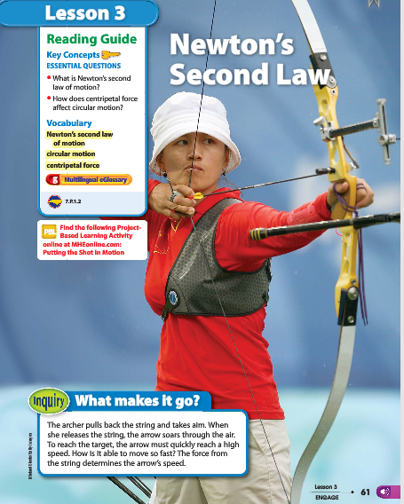
What makes it go- Inquiry
Look at the photo at the beginning of the lesson. The archer pulls back the string and takes aim. When she releases the string, the arrow soars through the air. To reach the target, the arrow must quickly reach a high speed.
How is it able to move so fast? The force from the string determines the arrow’s speed.

Slide 6
Lesson 3 Vocabulary
centripetal force a force in circular motion that acts perpendicular to the direction of motion toward the center of the circle
circular motion any motion in which an object is moving along a curved path
Newton’s second law of motion acceleration is equal to the net force exerted on the object divided by the object’s mass

Slide 7
Lesson Outline- A. How do forces change motion?
1. Forces change an object’s motion by changing its speed, its direction, or both.
2. Only unbalanced forces can change the velocity of an object.
3. You know unbalanced forces are acting on an object that is at rest when the object starts moving.
4. Unbalanced forces change the velocity of a moving object.
a. If a net force acts on a moving object in the direction that the object is moving, the object will speed up.
b. If a net force acts on a moving object in the direction that is opposite to the direction that the object moves, the object slows down.

Slide 8
A. How do forces change motion?
c. Another way unbalanced forces can change the velocity of a moving object is to change the direction of the object’s motion.
5. The force of gravity acts on a ball that is thrown by changing the direction of the ball, pulling it downward.
6. Another name for change in velocity over time is acceleration.
7. Unbalanced forces can make an object accelerate by changing the object’s speed, direction, or both.

Slide 9
B. Newton’s Second Law of Motion
1. According to Newton’s second law of motion, the acceleration of an object is equal to the net force acting on the object divided by the object’s mass.
2. The direction of acceleration is the same as the direction of the net force.
3. The units for Newton’s second law are SI units—force is measured in newtons; mass is measured in kilograms; acceleration is measured in meters per second squared.
4. One newton is the same as one kg· m/s2.

Slide 10
C. Circular Motion
1. Circular motion is any motion in which an object is moving in a curved path.
2. Inertia causes objects to tend to move along a straight path.
3. In circular motion, a force that acts perpendicular to the direction of motion toward the center of the curve is called a(n) centripetal force.
4. An object that is moving in a circle accelerates in the direction of the centripetal force.

Slide 11
C. Circular Motion
5. Any object that circles a larger object is called a(n) satellite.
a. Satellites move in a circle because a(n) centripetal force acts on them.
b. Gravity is the centripetal force that acts on satellites by continuously changing their direction of motion; this results in circular motion.
6. Earth’s gravitational pull keeps the Moon in orbit around Earth.
7. The planets remain in orbit because the Sun’s gravity pulls on them

Slide 12
Guided Practice 10 min
We are going to go over together. Please pay attention for the answer. I am not going to collect this assignment use for the help for Wednesday open notebook quiz.
1) F 2) T 3)T 4) T 5) F 6) F 7) T 8) T 9) T 10 ) F
Short Answer
1) Weight is a measure of the force of gravity pulling on an object of a given mass.
2) Weight is directly related to mass. As an object’s mass increases mass increases.
3) Weight= m . A = 50. 9.8= 490 newton.
Multiple Choice; 1) D 2) D 3) A 4) D 5) A 6) C

Slide 13
Independent Practice- 10 min
There are 12 questions (8 Content practice A) and 4 Content Practice B)
Each questions is 10 points.
If you are talk during independent practice you will get a 0.
No talking, group work, or brain storming.

Slide 14
Video 3 min
http://studyjams.scholastic.com/studyjams/jams/science/forces-and-motion/acceleration.htm

Slide 15
Homework
5 questions (School to Home Lesson 3)

