Slide 1
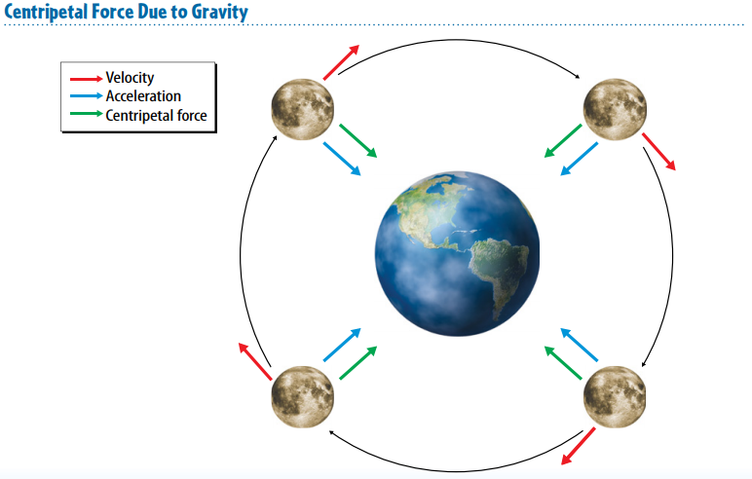
Warm up 5 min 4/17/18 Tuesday

Slide 2
Today Agenda
1) Warm up 5 min
2) Lesson 4; Introduction 3rd Law- 10 min
3) Lesson Outline 10 min
4) Video (Study Jams- Plicker) 20 min
5) Homework- School to Home 2 min

Slide 3
4
Newton's Third Law- Great Scientist Question
Why move up?
Look at the photo at the beginning of the lesson. To reach the height she needs for her dive, this diver must move up into the air. Does she just jump up? No, she doesn’t. She pushes down on the diving board and the diving board propels her into the air.
How does pushing down cause the diver to move up?

Slide 4
The Laws of Motion- First 5
Lesson 4: Newton’s Third Law
Newton’s third law of motion states that when one object applies a force on another, the second object applies an equal force in the opposite direction on the first object.
The forces of a force pair do not cancel because they act on different objects.
According to the law of conservation of momentum, momentum is conserved during a collision unless an outside force acts on the colliding objects.

Slide 5
Lesson Vocabulary- First 5
force pair: forces that two objects apply to each other
law of conservation of momentum: total momentum of a group of objects remains the same unless outside forces act on the objects
Momentum: measure of how hard it is to stop a moving object
Newton’s third law of motion: for every action there is an equal and opposite reaction

Slide 6
Lesson Outline-Lesson 4: Newton’s Third Law
A. Opposite Forces
1. When an object applies a force on another object, the second object applies a force of the same strength on the first object.
2. When an object exerts a force on another object, the second object exerts a force on the first object in the opposite direction.
B. Newton’s Third Law of Motion
1. According to Newton’s third law of motion, when one object applies a force on a second object, the second object applies an equal force in the opposite direction on the first object.
2. Any time a person pushes against a stationary object, the object exerts an equal and opposite force on the person.
3. A(n) force pair is the forces that two objects apply to each other.
a. The forces in a force pair are equal in strength and act in opposite directions. They do not cancel each other out because each acts on a different object.
b. For every action force, there is a reaction force that is equal in strength but opposite in direction of the action force.

Slide 7
C. Using Newton’s Third Law of Motion
1. When you push against an object, the force you apply is called the action force.
2. Newton’s third law establishes that the object you push on applies an equal and opposite reaction force against you.
3. According to Newton’s second law of motion, when the reaction force results in an unbalanced force, there is a(n) net force, and the object accelerates.
D. Momentum
1. Momentum is a measure of how hard it is to stop a moving object.
2. Momentum is the product of an object’s mass and its velocity.
3. According to Newton’s second law of motion, the force on an object is equal to the mass of the object multiplied by the acceleration, or the change in the object’s velocity.
4. Because momentum is the product of mass and velocity, the force on an object equals its change in momentum.

Slide 8
E. Conservation of Momentum
1. In any collision, one object transfers momentum to another object.
2. According to the law of conservation of momentum, the total momentum of a group of objects remains the same unless outside forces act on the objects.
3. One outside force is friction, which decreases the velocities of billiard balls and most other moving objects, and they lose momentum.
4. In a(n) elastic collision, the colliding objects bounce off each other.
5. In a(n) inelastic collision, the colliding objects stick together.
6. In elastic and inelastic collisions, the total momentum of all the objects is always the same before and after any collision.

Slide 9
Content practice 10 min
8 Question Each 12.5 point.
1. When an object exerts a force on a second object, the second object exerts an equal force in the opposite direction on the first object.
2. the action force and the reaction force
3. because they act on different objects
4. Student Answer .
5. momentum
6. 12 kg · m/s
7. The total momentum of a group of objects remains the same unless outside forces act on the objects.
8. Elastic collisions are collisions in which objects bounce apart after striking each other. Inelastic collisions are collisions in which objects stick together after colliding.

Slide 10
School To Home
4 questions.

