Slide 1
Warm Up 5 minutes 4/23/18 Monday

Slide 2
Bell Ringer Answer
1)The snowboarder can move down the mountain quickly because the mountain is steep and the snow is slippery. Friction, which opposes the pull of gravity, can be kept to a minimum.
2 The ride would be much slower and bumpier. Because grass and rocks are rougher than snow, they would slow down or stop a board that is gliding over them. Also, striking a large rock could harm the board or injure the rider.
3 No. Just as you cannot stop or slow yourself after you jump into the air, a snowboarder cannot stop his motion in the air

Slide 3
Today Agenda
1) Warm Up 5 minutes
2) Chapter 3; Energy and Energy Transformation Introduction 10 min
3) Video 15 min
4) Video Questions 15 min
5) Homework 3 min

Slide 4
Energy and Energy Transformations- Science Journal
What is energy and what are energy resources?
Energy is the ability to cause change. Energy transformations occur when one form of energy changes into another form of energy.

Slide 5
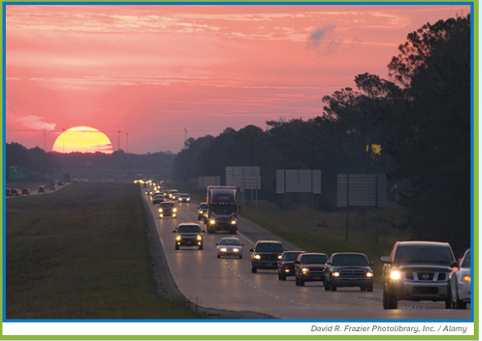
Energy and Energy Transformations- Science Journal
Which objects have energy?
Look at the photo at the beginning of the chapter. If your answer to the question above is “everything in the photo,” you are right. All objects contain energy. Some objects contain more energy than other objects. The Sun contains so much energy it is considered an energy resource.
•1)Where do you think the energy comes from that powers the cars?
2)Do you think the energy in the Sun and the energy in the green plants are related?
3) What do the terms energy and energy transformations mean to you?

Slide 6
Energy and Energy Transformations
Lesson 1: Forms of Energy
Energy is the ability to cause change.
Kinetic energy is the energy a body has because it is moving. Potential energy is stored energy.
Work is the transfer of energy that occurs when a force makes an object move in the direction of the force while the force is acting on the object.
Different forms of energy include thermal energy and radiant energy.

Slide 7
Energy and Energy Transformations
Lesson 2: Energy Transformations
According to the law of conservation of energy, energy can be transformed from one form into another or transferred from one region to another, but energy cannot be created or destroyed.
Friction transforms mechanical energy into thermal energy.
Different types of energy are used in many ways including providing energy to move your body, to light a room, and to make and to receive cell phone calls.

Slide 8
Video 15 min
1) Introduction Energy
2) What is Energy
3) Forms of Energy

