Slide 1
Warm up 5 minutes 4/26/18 Thursday
Use the example of fireworks to describe how potential energy can change into energy in other forms.
Give examples of these three forms of potential energy.
Describe the relationship between energy and work in your own words.
Answer
Unlit fireworks have potential chemical energy. When the fireworks are lit, the chemical reaction creates an explosion
A ball that someone bounces has gravitational potential energy. A guitar string has elastic potential energy. Gasoline has chemical potential energy
Work happens when a force makes an object move

Slide 2
Today Agenda
1) Warm Up 5 minutes
2) Lesson 2 Introduction- 5 min
3) Lesson Outline 10 min
4) Content Practice 15 min
5) Video (Brain Pop)/ Plicker/ Review 13 min
6) Content Vocabulary- Homework

Slide 3
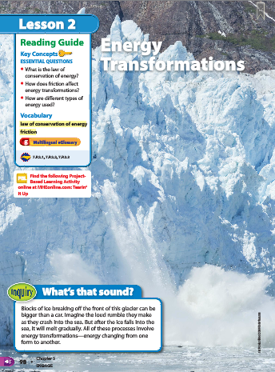
2
Energy Transformations
What’s the sound?
Look at the photo at the beginning of the lesson. Blocks of ice breaking off the front of this glacier can be bigger than a car. Imagine the loud rumble they make as they crash into the sea. But after the ice falls into the sea, it will gradually melt. All of these processes involve energy transformations—energy changing from one form to another.

Slide 4
Lesson 2 Vocabulary 5 min- Science Journal
friction force that resists the sliding of two surfaces that are touching
law of conservation of energy states that energy can be transformed from one form into another or transferred from one region to another, but energy cannot be created or destroyed
radiant energy transmitted by electromagnetic waves

Slide 5
Lesson 2: Energy Transformations Lesson Outline
A. Changes Between Forms of Energy
1. A microwave oven changes electrical energy to radiant energy.
2. The changes from electrical energy to radiant energy to thermal energy are energy transformations.
B. Changes Between Kinetic and Potential Energy
1. When you throw a ball upward, the ball has its greatest speed and the most kinetic energy when it first leaves your hand.
2. As the ball reaches its highest point, the ball gains its greatest potential energy.
3. As the ball moves downward, potential energy decreases and kinetic energy increases.

Slide 6
C. The Law of Conservation of Energy
1. According to the law of conservation of energy, energy can be transformed from one form into another or transferred from one region to another, but energy cannot be created or destroyed.
2. Friction is a force that resists the sliding of one surface over another.
a. There is always some friction between any surfaces that are in contact with each other.
b. As you pedal a bicycle, you do work and transfer energy to the bicycle.
c. Because of friction between moving parts of a bicycle, some of the work you do changes to thermal energy.
d. One way to reduce friction is to apply a(n) lubricant to surfaces that rub against each other.
e. When you apply brakes on a bicycle, the bicycle’s mechanical energy is not destroyed; instead, the bicycle’s mechanical energy is transformed into thermal energy. The total amount of energy remains the same.

Slide 7
D. Using Energy
1. You use thermal energy for cooking and heating.
2. Gas stoves and furnaces change chemical energy from natural gas into thermal energy.
3. During photosynthesis, plants transform radiant energy from the Sun into chemical energy stored in food.
4. Your body changes the chemical energy stored in food into kinetic energy as you move and into thermal energy, which keeps your body temperature high.
5. A television transforms electrical energy into sound energy and radiant energy.

Slide 8
D. Using Energy
6. Many devices you use every day are powered by electrical energy from electrical power plants.
7. With battery-powered devices, chemical energy is transformed into electrical energy for power.
8. When energy changes form, some thermal energy is always released. Scientists often refer to this energy that cannot be used as waste energy.
9. Cars transform most of the chemical energy in gasoline into waste energy.

Slide 9
Content Practice A-B 15 min
There are 10 blanks content A( 50 points)
There are 5 short answer Content B- (50 Points)
You can use your notes but you cannot talk or copy someone answer- it will be violation and 0 as a grade!!!
Good luck.

Slide 10
2
Energy Transformations
Energy can change from one form to another.
Agree. When energy is used, it is usually changed from one form to another.

Slide 11
2
Energy Transformations
Energy is destroyed when you apply the brakes on a moving bicycle or a moving car.
Disagree. Energy is transformed when you apply the brakes on a moving bicycle or a moving car.

Slide 12
2
Energy Transformations
The Sun releases radiant energy.
Agree. The Sun gives off energy that travels to Earth as electromagnetic waves. The energy that electromagnetic waves carry is radiant energy.

Slide 13
Brain Pop 10 min
Forms of Energy 1;52 second
10 questions on plicker.
Sources of Energy
https://www.brainpop.com/science/energy/energysources/
Plicker

