Slide 1
Warm Up 4/9/18 Monday 5 minutes

Slide 2
Answer of Bell Ringer
1.Stand on one’s hands, effort must be made to keep the body in balance.
2 There would be less friction between the dancer’s hands and the ice, so the dancer might slip.
3 Humans have never entirely escaped the pull of Earth’s gravity, although astronauts have experienced minimal gravity on journeys into space.

Slide 3
Today Agenda 47 min
1) Warm Up 5 minutes
2) New Chapter Introduction- Laws of Motion 10 min
3) Lesson 1- Gravity and Friction Introduction 10 min
4) Review 10 minutes
5) Brain Pop- Isaiac Newton 5 min
6) Plicker 5 questions- 7 min
7) No Homework today.

Slide 4
The Laws of Motion- Science Journal
How do forces change the motion of objects?
An object’s motion changes if a net force acts on the object.

Slide 5
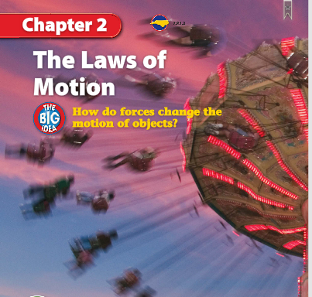
The Laws of Motion- Science Journal
Why move around?
Look at the photo at the beginning of the chapter. Imagine the sensations these riders experience as they swing around. The force of gravity pulls the riders downward. Instead of falling, however, they move around in circles.
• What causes the riders to move around?
• What prevents the riders from falling?
• How do forces change the motion of the riders?

Slide 6
The Laws of Motion- Science Journal
Chapter Introduction
Lesson 1: Gravity and Friction
Lesson 2: Newton’s First Law
Lesson 3: Newton’s Second Law
Lesson 4: Newton’s Third Law
Chapter Wrap-Up

Slide 7
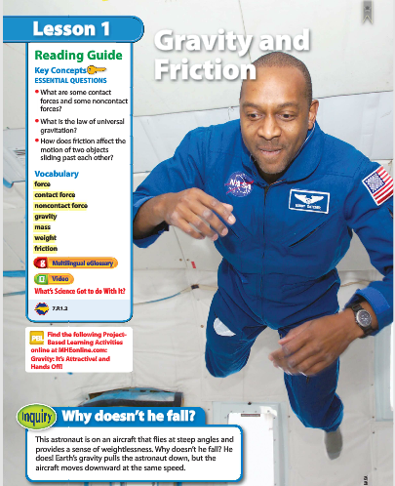
1
Gravity and Friction-No writing
Why doesn’t he fall?
Look at the photo at the beginning of the lesson. This astronaut is on an aircraft that flies at steep angles and provides a sense of weightlessness.
Why doesn’t he fall? He does! Earth’s gravity pulls the astronaut down, but the aircraft moves downward at the same speed.

Slide 8
The Laws of Motion- Science Journal
Lesson 1: Gravity and Friction
Friction is a contact force. Magnetism is a noncontact force.
The law of universal gravitation states that all objects are attracted to each other by gravity.
Friction can stop or slow down objects sliding past each other.

Slide 9
Lesson 1 Gravity and Friction Vocabulary
Contact force: a push or pull on an object by another object that is touching it
Force: a push or pull on an object
Friction force: that resists the motion of two surfaces that are touching
Gravity: attractive force that exists between all objects that have mass
Mass: amount of matter in an object
Noncontact force: a force one object can apply to another object without touching it
Significant: important; momentous
Static: at rest or having no motion
Weight: gravitational force exerted on an object

Slide 10
1
Gravity and Friction- Candy Question
You pull on objects around you with the force of gravity.
Agree. Gravity is an attractive force that exists between all objects that have mass.

Slide 11
1
Gravity and Friction- Candy Question
Friction can act between two unmoving, touching surfaces.
Agree. Static friction is a force that opposes the movement of two unmoving, touching surfaces.

Slide 12
1
Gravity and Friction- Candy Questions
What are some contact forces and some noncontact forces?
What is the law of universal gravitation?
How does friction affect the motion of two objects sliding past each other?

Slide 13
Brain Pop 15 min
Newton video (4;32 )
Plicker Questions

