Slide 1
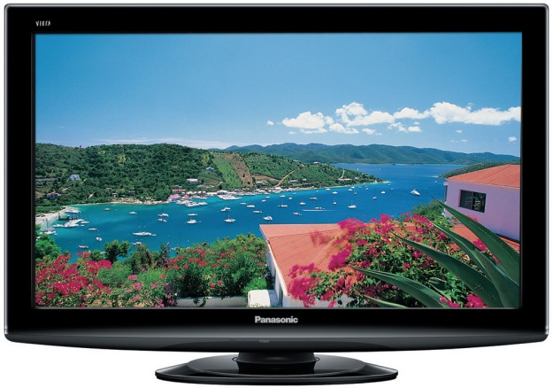
Warm Up 3 min
What kind(s) of energy are involved when a television is working?
Answer; electricity, light, heat, and sound
2) What types of energy can you find in this picture?
Answer; Thermal, light and mechanical energy
4/30/19 Tuesday

Slide 2
Today Agenda
1) Warm up 3 min
2) Lesson Outline 15 min
3) Video 5 min
4) Plicker 20 min
Important Reminder
1) Weekly Homework due is Friday (Energy packet)
2) Energy Quiz this Friday.
3) Progress Reports grade due is Friday.

Slide 3
Lesson Outline- Lesson 1: Forms of Energy
A. What is energy?
1. Energy is the ability to cause change.
2. Energy can cause an object to change its position or its motion.
B. Kinetic Energy—Energy of Motion
1. Energy due to motion is kinetic energy.
2. The faster an object moves, the more kinetic energy it has.
3. The kinetic energy of an object depends on its mass as well as its speed.
4. If two objects move at the same speed, the object with the greater mass will have more kinetic energy

Slide 4
C. Potential Energy—Stored Energy
1. Potential energy is stored energy.
2. When you are holding a book, energy is stored between the book and Earth; this type of energy is called gravitational potential energy. This type of potential energy stored between an object and Earth depends on the weight and height of the object.
3. Elastic potential energy is energy stored in objects that are compressed or stretched.
4. When you stretch a rubber band, you are storing elastic potential energy. When you let go of the rubber band, the stored potential energy is transformed into kinetic energy.
5. Food has chemical potential energy, which is the energy stored in the bonds between atoms. This energy is released when chemical reactions occur.

Slide 5
D. Energy and Work
Work is the transfer of energy that occurs when a force is applied over a distance.
Energy is sometimes described as the ability to do work.
E. Other Forms of Energy
1. Energy can be measured in units of joules.
2. Mechanical energy is the total kinetic energy and potential energy in an object or group of objects.
3. The energy carried by sound waves is sound energy. It is produced by objects that vibrate.
4. All materials are made of atoms and molecules that are always moving. The energy of atoms and molecules due to their motion is thermal energy.
5. Electrical energy is the energy carried by an electric current.

Slide 6
E. Other Forms of Energy
6. Electromagnetic waves, such as microwaves, can travel through a vacuum.
7. The energy of electromagnetic waves is called radiant energy.
8. Nuclear energy is stored in the nucleus of an atom.
9. The Sun releases nuclear energy when the nuclei of atoms join together.
10. Nuclear power plants release energy by splitting nuclei.

Slide 7
Video (5 min)
https://www.brainpop.com/science/energy/formsofenergy/
https://www.youtube.com/watch?v=FX7T-QYTPho

Slide 8
Plicker

