Slide 1
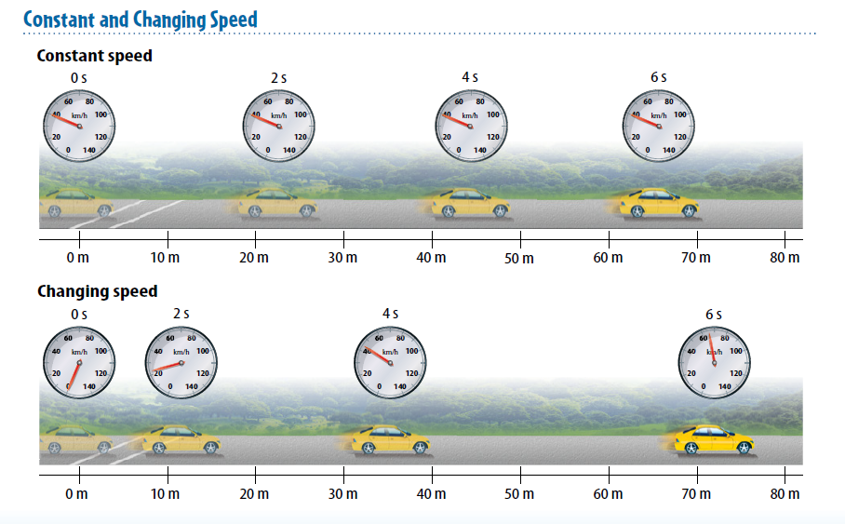
4/3/19 Wednesday 3 min Warm Up Describe the difference between picture one and two.

Slide 2
Today Agenda
1) Warm Up 3 min
2) Content Practice 20 min
3) Video 5 min
4) Plicker 15 min
Important Reminder
Weekly Homework is due Friday
Chapter quiz this Friday (Motion)
Permission slip is due with money Friday.

Slide 3
Content Practice A (page 13)
1–2. (in either order) distance, direction
3. reference point
4. displacement
5. difference
6. initial
7. final
8. (in either order) positive, negative
9. motion
10. distance, displacement

Slide 4
Content Practice B (page 14)
1. position
2. reference point
3. distance
4. direction
5. reference point
6–7. (in either order) positive, negative
8. motion
9. position
10–11. (in either order) distance, displacement
12. displacement
13. distance

Slide 5
Content Practice A (page 30)
1. distance, time
2. constant
3. Instantaneous
4. average
5. steep
6. horizontal
7. velocity, direction

Slide 6
Content Practice B (page 31)
1. Students should draw a straight line from the bottom left corner to the 75 km/h point on the far right.
2. Students should draw a straight line from the bottom left corner to the 1-km mark after 30 seconds; a horizontal line to the 60-second mark; a straight line to the upper-right corner.
3. its speed and direction of motion
4. by changing its speed, its direction, or its speed and direction

Slide 7
Content Practice A (page 50)
1. (in either order) speed, direction
2. velocity
3. forward, backward
4. y-axis, x-axis
5. increasing
6. decreasing
7. constant

Slide 8
Content Practice B (page 51)
1. a horizontal line from time zero to the 5-second mark at a speed of 50 km/h; a vertical line down to zero km/h; a horizontal line extending to the 10-second mark
2. Acceleration is a measure of how much the velocity of an object changes in a unit of time.
3. It is in the opposite direction.
4. It is accelerating because it is changing direction, which is a change in velocity.
5. a is acceleration; v f is final velocity; v i is initial velocity; t is time.

Slide 9
Video
https://www.youtube.com/watch?v=4dCrkp8qgLU&t=29s
https://www.youtube.com/watch?v=bqf8m7xNvLg&t=10s

Slide 10
Plicker

