Slide 1
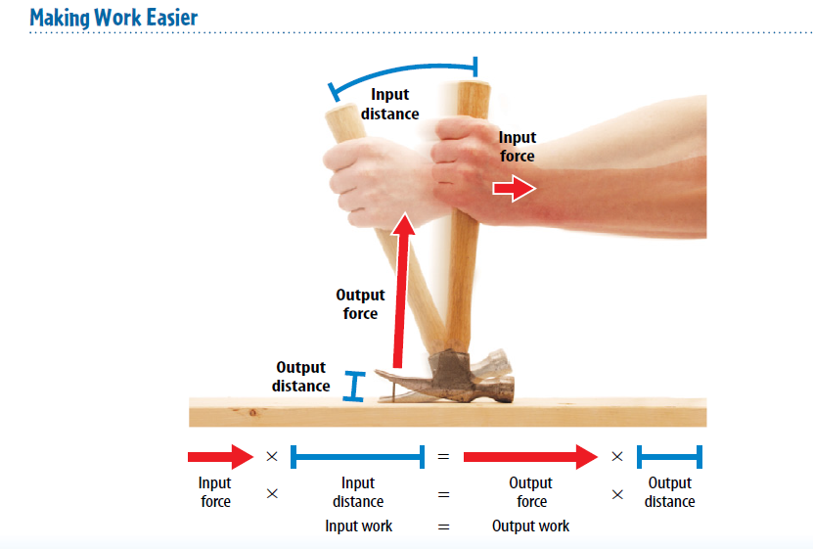
Warm Up 5 minutes 5/11/18 Friday Explain the how input work is equal to output work.

Slide 2
Today Agenda
1) Warm Up 5 minutes
2) Chapter Quiz 20 minutes (Open Note)
3) CK12 Simple Machine 10 minutes
4) Kahoot 12 minutes

Slide 3
Chapter Quiz
There are 20 questions total.
Go to www.socrative.com
Click student log in
Room Name; Bophorus/Berkeley1/Caltech1/Umad/Texasam
Your student ID same as Plicker number
You can retake last week quiz to change to room tmsacomputer
You don’t want to retake your quiz go to CK12. org for simple machine assignment.

Slide 4
CK12- 10 minutes
There are 5 assignments.
You don’t have to do CK12 assignment just say I don’t want to do it, I want a big fat *0* in my powerschool then enjoy whatever.
Last 10 minutes we will play Kahoot.
Username; firstnametmsa
Password; tmsa2017

Slide 5
Kahoot- 10 minutes
https://play.kahoot.it/#/?quizId=badbf095-dbf1-4a5c-a5bf-b5740da817fe

