Slide 1
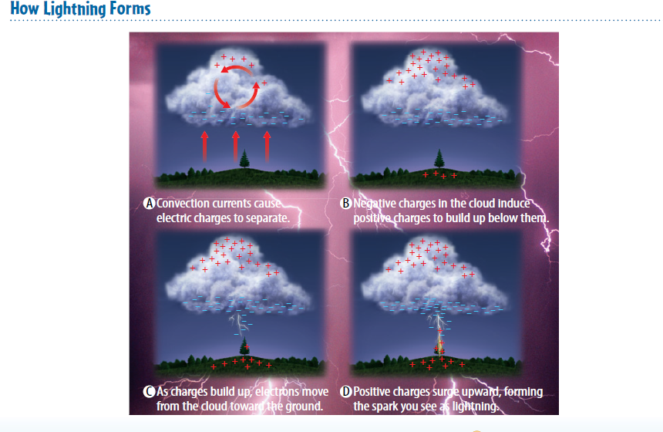
Warm Up 5 minutes 5/15/18 Tuesday How Lightning Forms , explain the process.

Slide 2
Today Agenda- 47 min
1) Warm Up 5 minutes
2) Lesson Vocabulary 5 minutes
3) Lesson Outline 10 minutes
4) Content Practice 10 minutes
5) Brain Pop 15 minutes
6) Homework (School to Home) 2 min

Slide 3
Lesson 1 Vocabulary- 5 min
Conductor: material through which electrons can move easily
electric discharge: loss of an unbalanced electric charge
Grounding: providing a path for electric charges to flow safely into the ground
Insulator: material through which electrons cannot move easily
Polarized: describes an object that has electrons concentrated at one end
static charge: unbalanced electric charge on an object

Slide 4
Lesson Outline for Teaching Lesson 1: Electric Charge and Electric Forces
A. Electric Charges
1. Atoms are made of protons, neutrons, and electrons.
a. Protons and neutrons make up the nucleus of an atom.
b. Electrons move around the nucleus.
2. There are two types of electric charge—positive and negative.
a. A(n) proton has positive charge. A(n) electron has negative charge.
b. The amount of positive charge of a proton equals the amount of negative charge of an electron.
3. An atom is electrically neutral when it has equal numbers of protons and electrons.
4. Electrically neutral objects do not attract or repel one another.
5. Objects can become charged when electrons move from one object to another.
a. A(n) static charge is an unbalanced electric charge on an object.
b. An object that gains electrons has a(n) negative charge.
c. An object that loses electrons has a(n) positive charge.

Slide 5
B. Electric Forces
1. A(n) electric field surrounds every charged object.
a. An electric field applies a(n) electric force to other charged objects.
b. When two charged objects have the same type of charge, the objects repel each other. When two charged objects have different types of charge, the objects attract each other.
2. The strength of an electric force between charged objects depends on the amount of charge on each object and the distance between them.
a. If the distance between two charged objects stays constant, then electric force increases as the total amount of charge of the two objects increases.
b. If the amount of charge on two objects stays constant, then electric force increases as the objects move closer together.

Slide 6
C. Transferring Electrons
1. If electrons cannot easily move through a material, then the material is a(n) insulator.
2. If electrons easily move through a material, then the material is a(n) conductor.
3. Electrons can transfer between objects by contact, induction, or conduction.
When objects touch each other, charge can be transferred by contact.
When charge is transferred by induction, an object causes two objects that are not conductors to become charged.
An object is polarized when electrons are concentrated at one end of the object.
When conductors with unequal charge touch, electrons flow from the object that has a greater negative charge to the object that has less negative charge in the process of conduction.

Slide 7
D. Electric Discharge
1. A(n) electric discharge is the loss of an unbalanced electric charge.
2. Electric discharges can occur slowly, such as when you brush your hair, or they can occur quickly, such as when lightning strikes.
3. A lightning rod is grounded, which means it provides a path for electric charges to flow safely into the ground.

Slide 8
Content Practice A
1. An unbalanced charge forms on the object.
2. Electrons move from one object to another.
3. Electric force is applied to other charged objects.
4. The objects repel each other.
5. The objects attract each other.
6. A flash of light, called lightning, occurs.

Slide 9
Content Practice B (page 14)
1. When an object that is negatively charged comes close to an object that is positively charged, the objects attract.
2. The opposite electric charges of the hairbrush and hair attract.
3. Copper is a good conductor of electricity. Plastic is a good insulator
4. When the electrons in a cloud come close to the ground, they move toward the positively charged ground or objects on the ground, causing a lightning strike.

Slide 10
Brain Pop (Static Electricity)
https://www.brainpop.com/science/energy/staticelectricity/
Video 4;08
Plicker questions 10

Slide 11
Homework
School to Home 4 questions (Lesson 1)

