Slide 1
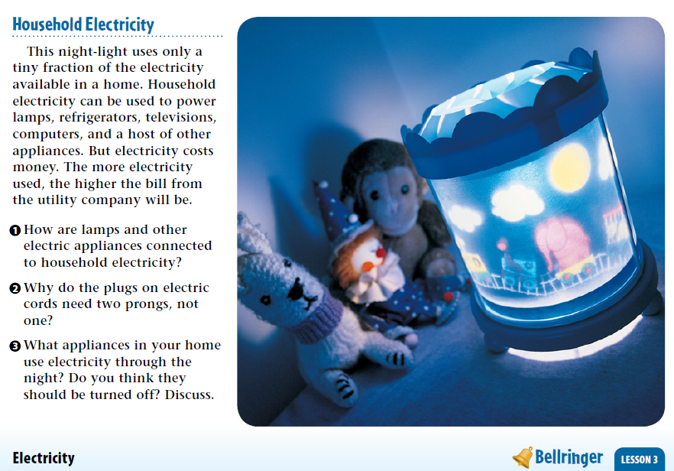
Warm Up 5 min 5-17-18 Thursday

Slide 2
Warm Up Answer
1. An electric cord and plug connects the appliance to the outlet.
2 Electric current travels in a closed loop. Two
prongs are needed to carry electricity in a circuit to
and from the appliance.
3 Some televisions and computers are configured
to always use a small amount of electricity, even
when they are not in use.

Slide 3
Today Agenda
1) Warm Up 5 minutes
2) Lesson Vocabulary 5 minutes
3) Lesson Outline 7 minutes
4) Content Practice 15 minutes
5) Brain Pop (Current Electricity/ Plicker) 15 minutes
6) Homework- School to Home

Slide 4
Lesson Vocabulary 5 min
device piece of equipment
parallel circuit electric circuit with more than one path, or branch, for an electric current to follow
series circuit electric circuit with only one closed path for an electric current to follow

Slide 5
Lesson 3: Describing Circuits- Lesson Outline
A. Parts of an Electric Circuit
1. An electric circuit transforms electric energy to other forms of energy.
2. An electric circuit contains a(n) energy source.
a. A(n) battery is often used as an energy source.
b. As chemicals react within a battery, the battery’s positive terminal loses electrons and its negative terminal gains electrons.
c. When the terminals are connected in a closed circuit, electrons flow from the negative terminal of a battery to the positive terminal.
3. An electric circuit contains at least one electric device that transforms energy.
a. Within a battery, chemical energy transforms into kinetic energy of moving
electrons.
b. When the electrons flowing in a conductor collide with the atoms that make up
the conductor, the electrons transfer some of their kinetic energy to the atoms.
4. An electric circuit contains wires that connect its components.
a. Wires that connect components of a circuit have low electric resistance.
b. Only a small amount of electric energy is transformed into thermal energy by
wires, which means that more energy is available for useful devices in the circuit.

Slide 6
B. Series and Parallel Circuits
1. A(n) series circuit is an electric circuit that has only one closed path for an electric
current to follow.
a. Because there is only one path, when a series circuit is open, all devices turn off.
b. Adding devices to a series circuit adds resistance to the circuit and decreases the
current in the circuit.
2. A(n) parallel circuit is an electric circuit that has more than one closed path for an
electric current to follow.
a. Most circuits in homes are parallel circuits.
b. In a parallel circuit, each device has its own path, or branch, that connects it to
the source.
c. If you open one branch of a parallel circuit, current continues through other
branches.
d. Adding devices and branches to a parallel circuit increases the total electric
current through the battery.

Slide 7
C. Electric Circuits in the Home
1. Electric energy is generated at large power plants.
2. Before entering your house through a main wire, the main wire passes through a(n) electric meter, which measures the electric energy used in your home.
3. Fuses and circuit breakers are safety devices that keep the current in a circuit from becoming too high.
4. A(n) GFCI is a safety device in an electric outlet that opens a circuit to stop current flow, which can help protect you from electric shock.
D. Electric Safety
1. An electric shock occurs when a(n) electric current passes through the human body.
2. Ways to protect yourself from electric shock include staying away from water while using electric devices, avoiding using extension cords, and not contacting electric power lines.

Slide 8
Content Practice 15 min
17 questions total , you have 15 minutes to finish. Use your lesson outline.
You have a questions just let me know.

Slide 9
Brain Pop- Electric Circuits
https://www.brainpop.com/science/energy/electriccircuits/
Video 3;42
Plicker 10 questions

Slide 10
Homework
School to Home (Describing Circuit)

